Slide 1



Reproductive Health and Fertility Education
A teacher resource
Slides produced by the International
Reproductive Health Education Collaboration
Which is part of ESHRE (www.eshre.eu/IRHEC)
Please use with the teacher guide
Notes:
Feel free to edit these slides as you wish. See accompanying document produced by the International Reproductive Health Education Collaboration which will explain how to use these slides. We have also made additional resources to use with this ppt – this includes some personal stories about various reproductive health issues, 12 free information leaflets, and a fertility education poster – all of these are available on our web site.

Slide 2


ESHRE and International Reproductive
Health Education Collaboration
ESHRE
European Society of Human Reproduction and Embryology
aims to promote interest in, and understanding of, reproductive biology and medicine.
International Reproductive Health Education Collaboration
The International Reproductive Health Education Collaboration (IRHEC) is a multidisciplinary global collaboration dedicated to improving reproductive health education.
Notes:
We want teachers to know who we are. You do not need to use either of the first slides.

Slide 3









What is reproductive health?
Puberty
Menstrual
cycle and
periods
Fertility
Contraception
Sexually
Transmitted
Infections
Infertility
Pregnancy
Menopause
Andropause
Cancers that affect the reproductive system
Wellbeing
and
lifestyle
Notes:
This resource focuses on topics of reproductive health that are not covered in any detail in most schools and includes heterosexual as well as LGBTQ+ reproductive options. In studies conducted in the UK, Belgium, Greece and Sweden, teenagers told us it was important to ensure education is LBGTQ+ inclusive. This resource is not just about having children – it covers reproductive health including issues that affect young people now, such as menstruation and contraception.

Slide 4

Why we want to teach reproductive health
To help you look after
your reproductive health
To give you the best possible chance
of achieving your reproductive goals, whatever they might be!
Want children
in the future
Don’t want
children
Not
sure
Notes:
We need to teach this, whether people want children or not. Some topics are directly related to having children, but not all, such as PCOS, endometriosis and menopause.

Slide 5
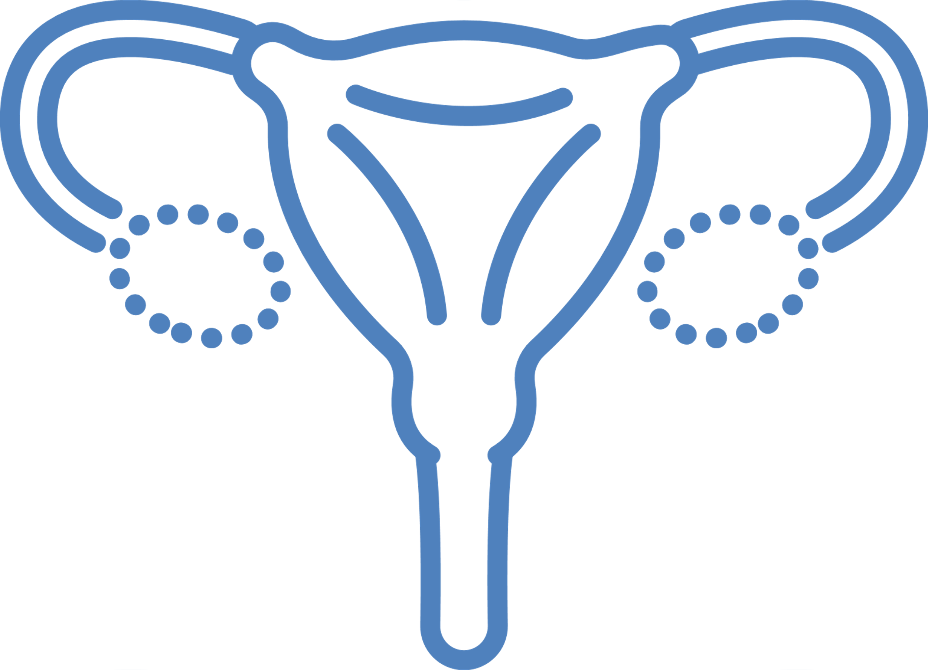

Puberty
Notes:
Feel free to edit these slides as you wish. See accompanying document produced by the International Reproductive Health Education Collaboration which will explain how to use these slides.

Slide 6
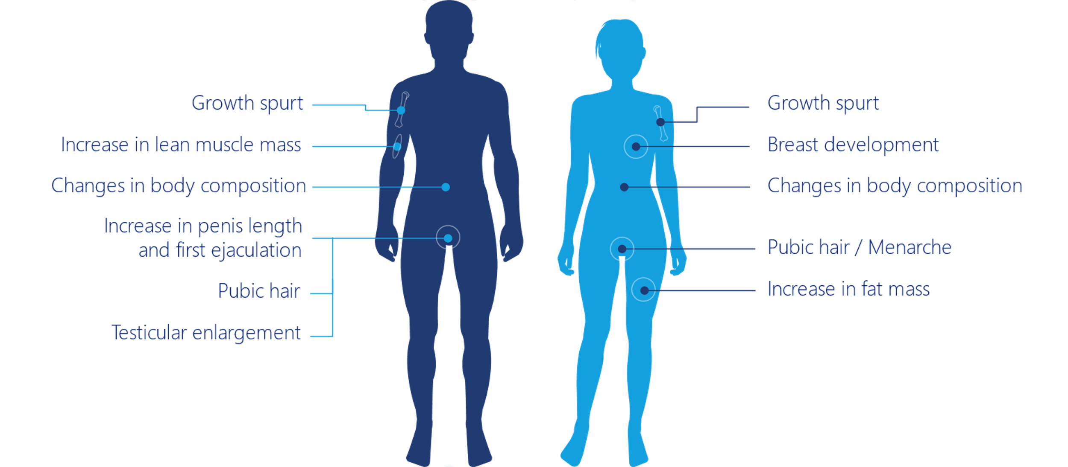
Puberty
General changes | Changes in female | Changes in male
 | Start between age 8 and 13 | Start between age 9 and 14
Changes in your body | Develop breasts and pubic hair | Testicles and penis get bigger Pubic hair develop Facial and body hair increases
 | Change in body shape | Deepening of voice
Able to reproduce | Periods start | Sperm produced
Everyone will experience puberty
in a different way
Notes:
You probably have covered puberty at younger ages. It might be useful to use this slide to revisit puberty and see if the students have any questions.

Slide 7
Hormones in males
Follicle stimulating hormone (FSH)
stimulates production of sperm
Luteinising hormone (LH)
helps produce testosterone
Testosterone
regulates sex drive (libido), bone mass, fat distribution,
muscle mass and strength, and the production of sperm
Oestrogen
affects libido, erectile function, and production of sperm
Progesterone
building block for many hormones and for male characteristics
Notes:
The students may have covered some aspects of hormones in biology. This slide and the next are useful to revisit this and to point out that females and males have the same hormones but they do different things.

Slide 8
Hormones in females
Follicle stimulating hormone (FSH)
regulates menstrual cycle and stimulates the egg to grow
Lutenising hormone (LH)
helps produce hormones, regulates menstrual cycle and ovulation
Oestrogen
needed for puberty, the menstrual cycle, pregnancy,
bone strength and other functions of the body
Progesterone
prepares the womb for the embryo to implant in
Testosterone
helps with the growth, maintenance, and repair of female reproductive tissue and bone mass, and influences female sexual behaviour
Notes:
It is important to understand these hormones in relation to the menstrual cycle. We will come back to this in the fertility and infertility sections. Hormones are very powerful and can have a profound effect on females throughout the month as they oscillate. They can seriously affect a female’s mental and physical health.
Question – ask the students if they feel their hormones affect their mental and physical health?
We have an information leaflet on the menstrual cycle which may be useful.

Slide 9
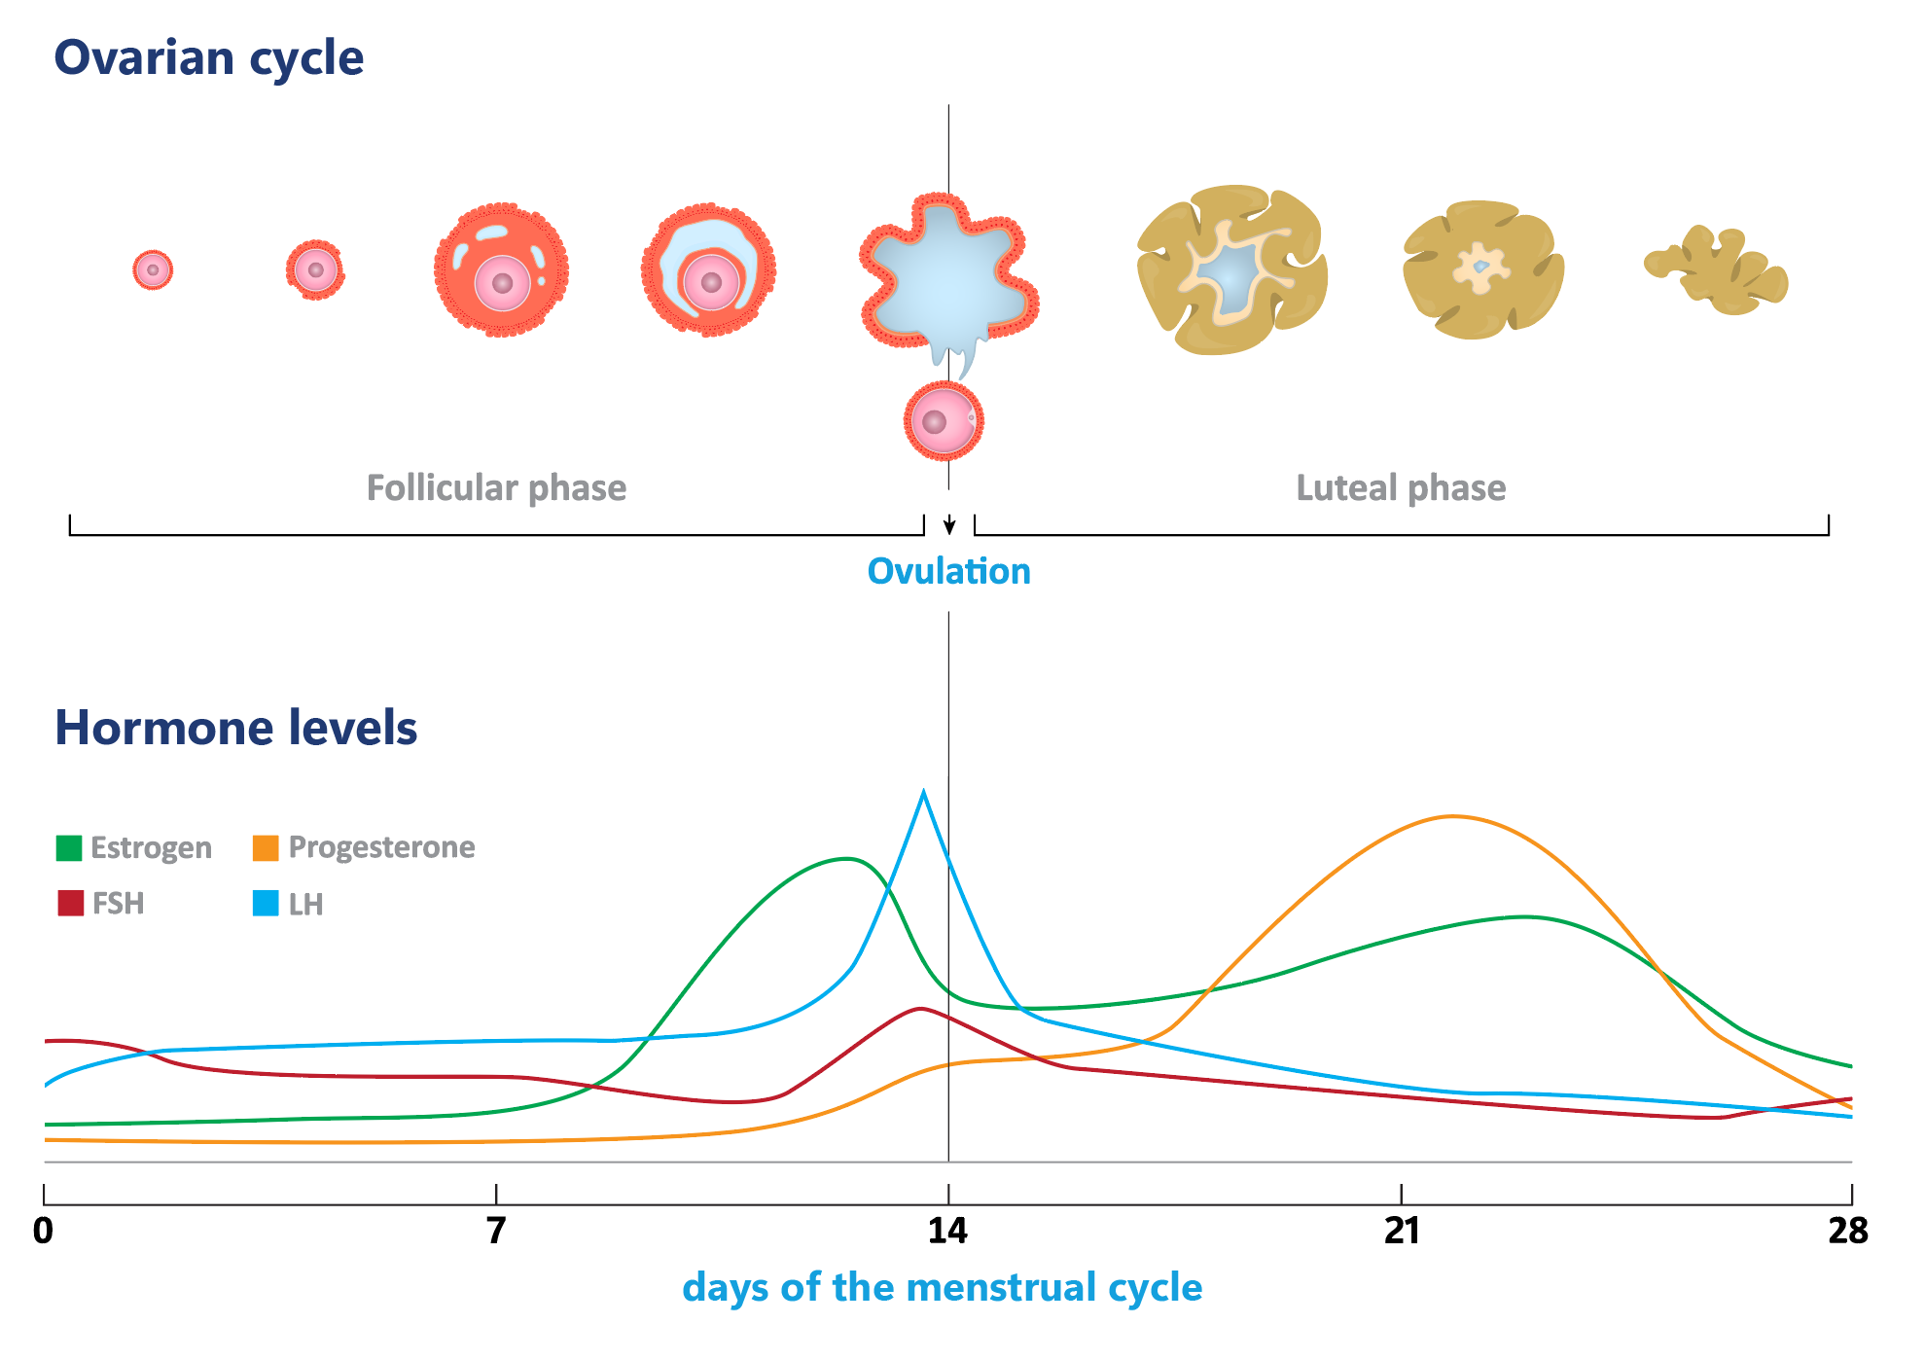
Hormones in females
They control ovulation and the period
Levels of the different hormones vary
throughout the menstrual cycle
These hormone changes may have positive
and negative effects on physical and mental
health
Notes:
You may wish to use this slide to show how the hormones change through the cycle.
Question – ask the students if they feel their hormones affect their mental and physical health?

Slide 10

Menstrual cycle and periods
Notes:
Each topic is separated into sections so you can easily pull-out slides on a particular topic to make a simple lesson plan. You can add in questions from the guide, and use the information leaflets we have produced.

Slide 11
The menstrual cycle
From puberty to menopause
Two key events
Period
Starts between ages 10 and 15 and
may be irregular for the first few years
Bleeding from the vagina which is the
shedding of the lining of the womb
All females are different and will have
a wide range of menstrual cycle
experiences
The normal cycle length is a period every
21-35 days
Length of a typical period: <8 days
Volume:
bleeding varies from very light to so
heavy that it stops you doing what
you want to do
Ovulation
Ovulation happens from day
10 to day 25, most commonly
between days 14-18
Notes:
You may have covered aspects of the menstrual cycle in your school. Starting this talk with the menstrual cycle, which is topical for the people in your class now, will hopefully encourage engagement with some of the other topics, such as having children and the menopause, which might seem distant to teenagers. It is also important for males to understand what issues females have with their menstrual cycle, especially during their periods. If the school is mixed-sex, we would encourage this to be discussed in a mixed-sex class. Teenagers have told us they want everyone to understand about the menstrual cycle and menstruation.
The length of the menstrual cycle – from the start of one period to the start of the next with the first day of the period being day 1. It is important for students to understand what is a normal menstrual cycle length, how many days they should bleed, the volume of blood and how varied the day of ovulation can be. If they are having a longer or shorter cycle, they may wish to speak to their doctor.
Apps can be useful for knowing roughly when a period may start but they are not always accurate in predicting the period start date and people should not worry if their period comes earlier or later than the app says. Many of the period tracker apps predict ovulation but this is only an estimate. It is important not to use this information as a form of contraception as it is very inaccurate.
Questions:
For those who have periods, have you ever used an app to monitor your menstrual cycle? Yes, No, Not sure
If you use a period tracker app – does it tell you the day you ovulate? Yes, No, Not sure
See the leaflet on the menstrual cycle. Here is a video about menstruation - https://www.youtube.com/watch?v=gQxrARdTVwk

Slide 12
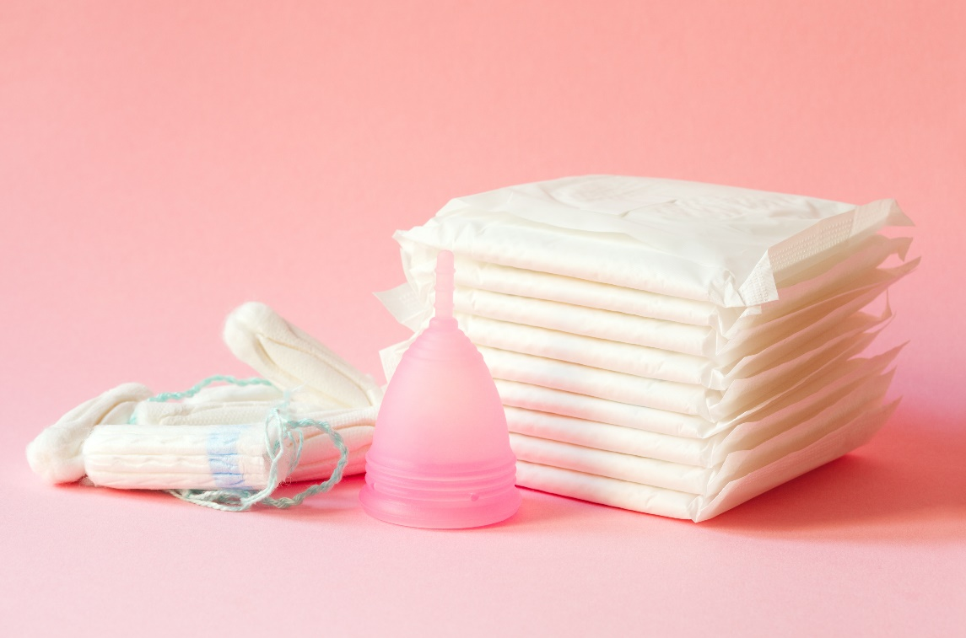
Period products
There are many types of period products
Use one that suits you
Period pads
Tampons
Menstrual cups
Period pants
Period tights
Many schools have a supply of period products for you to use
Change your product regularly to prevent leakage.
It is especially important to change tampons regularly
to avoid infections as well as leakage
Notes:
Recent studies have indicated that many people wish to have more in depth education about periods and period products. If your school has free period products, this gives an opportunity to explain where they are stored. These products should be easily accessible.

Slide 13

What teenagers say about their periods
Do you have any ssues with your periods?
Pain, irregular, heavy, etc
A bit of pain, but no many issues yet
Back pain, intense pain that I can’t move sometimes
Very heavy and painful with cramps and headaches as well
as back pain as well as being irregular
You don’t need
to suffer in silence
If you are worried about your wellbeing – you may wish to speak to your doctor or pharmacist
Pain to the point I used to collapse. Now on the pill and have no issues
Painful first two days
Pain and heavy periods
Heavy, usually lasts 10 day, irregular and so much pain (now diagnosed with endometriosis and hormone deficiency)
Back cramps, bowel problems
Notes:
In a class it was asked if they had any issues with their periods. This slide shows some of their responses. Many reported serious problems which affected their wellbeing. Ask your students if they have any concerns about their periods. If they are having problems that affect their daily lives, suggest that they see their doctor as there are treatments that can help them.
Question: For those who have periods, do you have any issues with them, such as pain, irregular, heavy, periods, etc?

Slide 14
Premenstrual syndrome (PMS) or tension (PMT)
How common is it?
20-40% of females but
this means 60-80% do not
What is it?
Symptoms that may start
a few days to two weeks
before a period is due
What possible symptoms can it cause?
Possible physical symptoms
● breast tenderness ● bloating ● lethargy
● weight gain ● nausea ● constipation
● diarrhea ● insomnia ● backache ● joint ache
● headache ● migraines ● acne
Possible emotional symptoms
● mood swings ● anger ● aggression
● depression ● irritability ● crying
● anxiety ● clumsiness ● loss of libido
● food cravings for sweet and salty food
● poor concentration ● forgetfulness
What are the treatments?
Usually resolve when the period begins
- exercise and nutrition might help
But if it affects your wellbeing –
you may wish to see your doctor
5% of females:
Premenstrual Dysphoric Disorder (PMDD)
when PMS is so severe - cannot lead a
normal life
Notes:
You may have covered PMS previously but it is good to discuss again and to see how they are coping with this.
Question: Is PMS affecting their time at school?

Slide 15


PCOS - Polycystic Ovary Syndrome
How common is it?
It affects about 1 in 10 females
What is it?
A condition that affect how the ovaries
work and may have other health issues
Imbalance of sex hormones
What possible symptoms does it cause?
Irregular or no periods
Weight gain and difficulty losing weight
Reduced fertility
Acne
Excess hair growth
Mood swings and irritability
Problems with sugar metabolism
What are the treatments?
  Eat healthy – especially reducing sugar
  Regular exercise
  Hormonal treatments e.g.
  the contraceptive pill
If you think you have PCOS,
you may wish to see your doctor
PCOS AFFECTS
1-IN-10 FEMALES
Notes:
It is important to know about PCOS as chances are, some in your class will be affected and some may already have a diagnosis. The symptoms are shown in the graphic but also extra key symptoms are listed in the bullet points. It should be pointed out that if they think they have this, they should go to their doctor. See the information leaflet on PCOS.

Slide 16
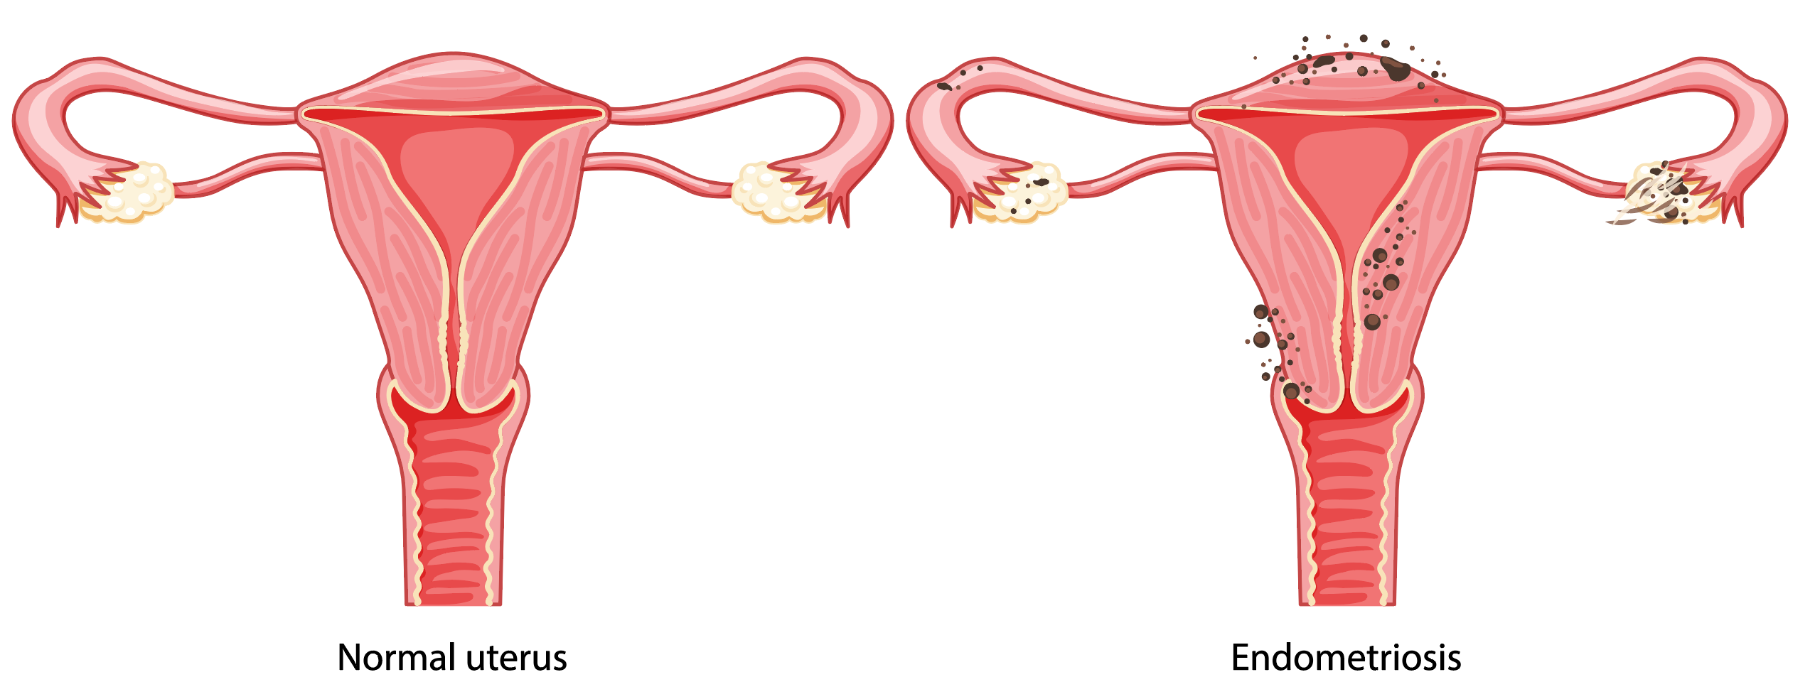
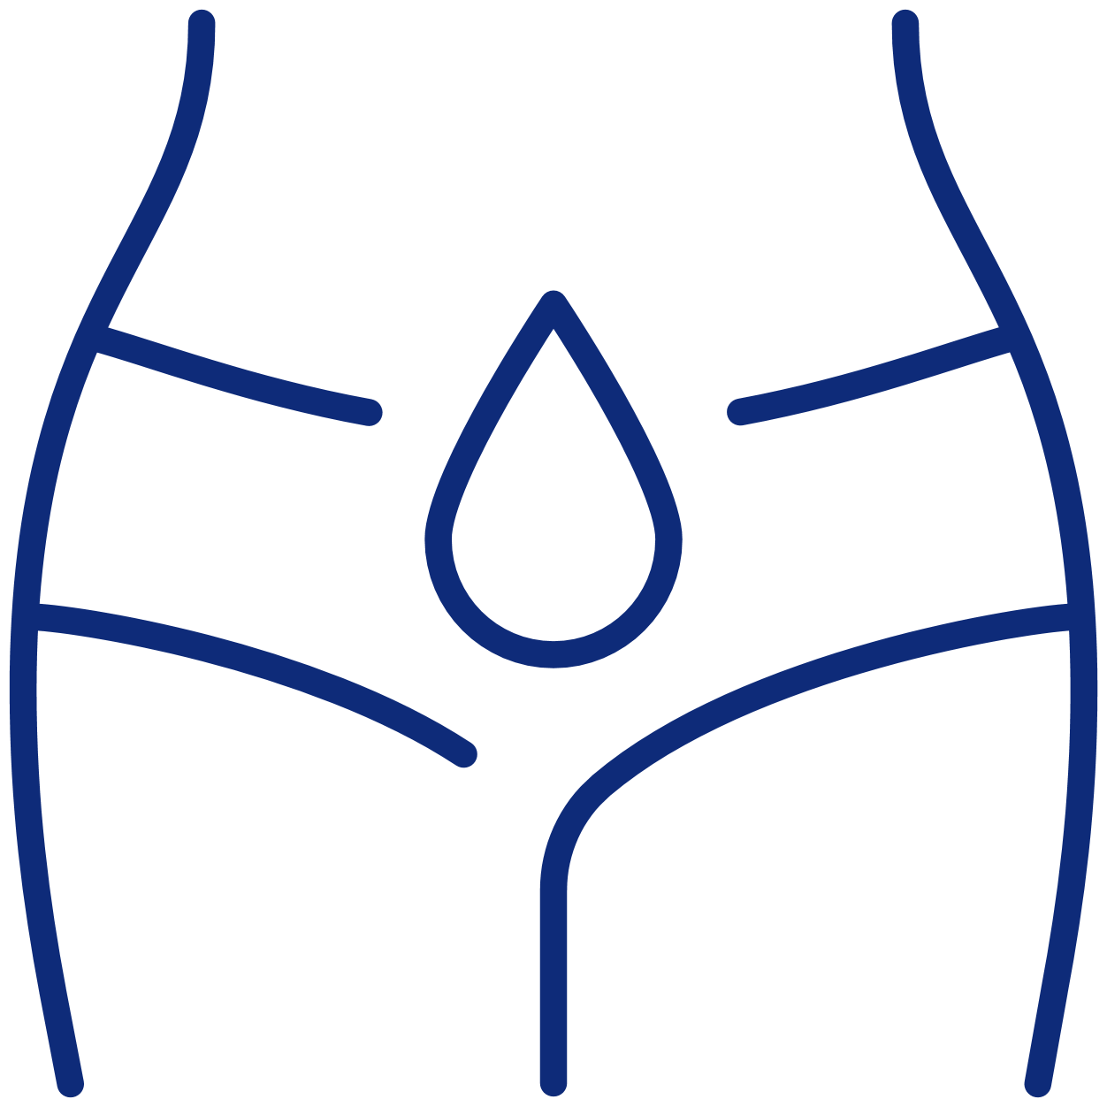


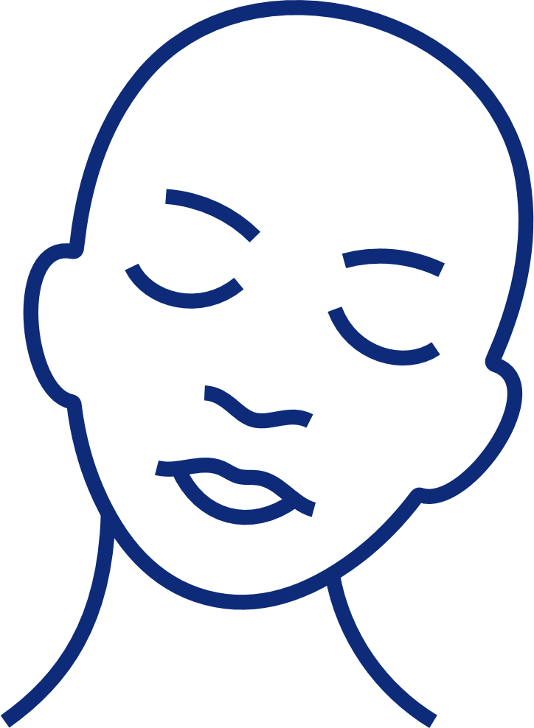
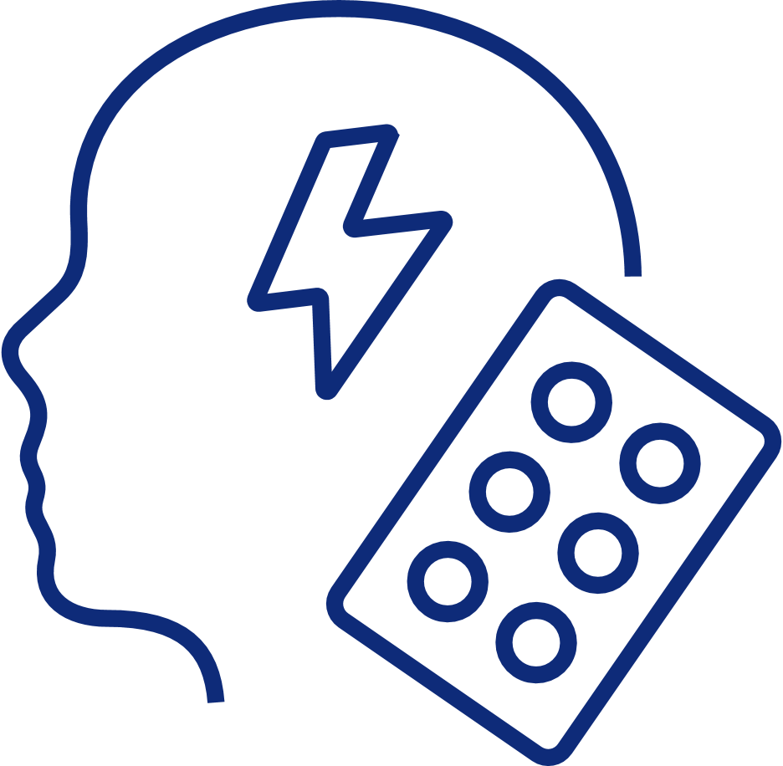

Endometriosis
How common is it?
It affects about 1 in 10 females
What is it?
Tissue similar to the inside lining of the womb is found outside the womb.
What possible symptoms
can it cause?
  Painful periods that do not respond
  to simple pain killers
  Lower abdominal pain or cramp
  during urination and defecation
  Deep pelvic pain during sex
  Lack of energy
  Depression
  May lead to physical, sexual, psycho-logical and social wellbeing problems
What are the treatments?
  Most respond well to
  hormonal treatment e.g combined pill or hormonal
  coil
  Those with severe
  symptoms may need
  surgery
If you think you have
endometriosis – you may
wish to see your doctor
Painful periods that do not respond to simple pain killers
Lower abdominal pain or cramp during urination and defecation
Deep pelvic
pain during
sex
Lack of
energy
Depression
physical, sexual, psychological
and social
wellbeing
problems
Notes:
Chances are some of your class have endometriosis. If they think they have this, they should see their doctor. Females should not be suffering these conditions in silence. They should seek medical help.
See the information leaflet on endometriosis. Here is a video about endometriosis - https://www.youtube.com/watch?v=34syY5N5ZQA

Slide 17
Fibroids and Adenomyosis
How common is it?
Fibroids occur in up to 1 in 3 females, more common as females get older
They may not produce any symptoms
What is it?
Fibroids
Overgrowth of the muscle layer of the womb, usually forming a ‘ball’ of muscle tissue.
Adenomyosis
where the lining of the womb migrates into the muscle layer of the womb
What possible symptoms
can it cause?
Fibroids
heavy periods, pressure symptoms, sometimes fibroids can make it more difficult to get pregnant
Adenomyosis
heavy, painful periods, may make it more difficult to get pregnant
What are the treatments?
Hormonal treatments, e.g., contraceptive pill or hormone intrauterine device and/or surgery
Submucosal fibroids
Intramural fibroids
Subserous fibroids
Notes:
These are relatively common conditions. Again it is possible that these conditions affect someone in your class and they can often take years to diagnose. If they have any worries, they should see their doctor.

Slide 18
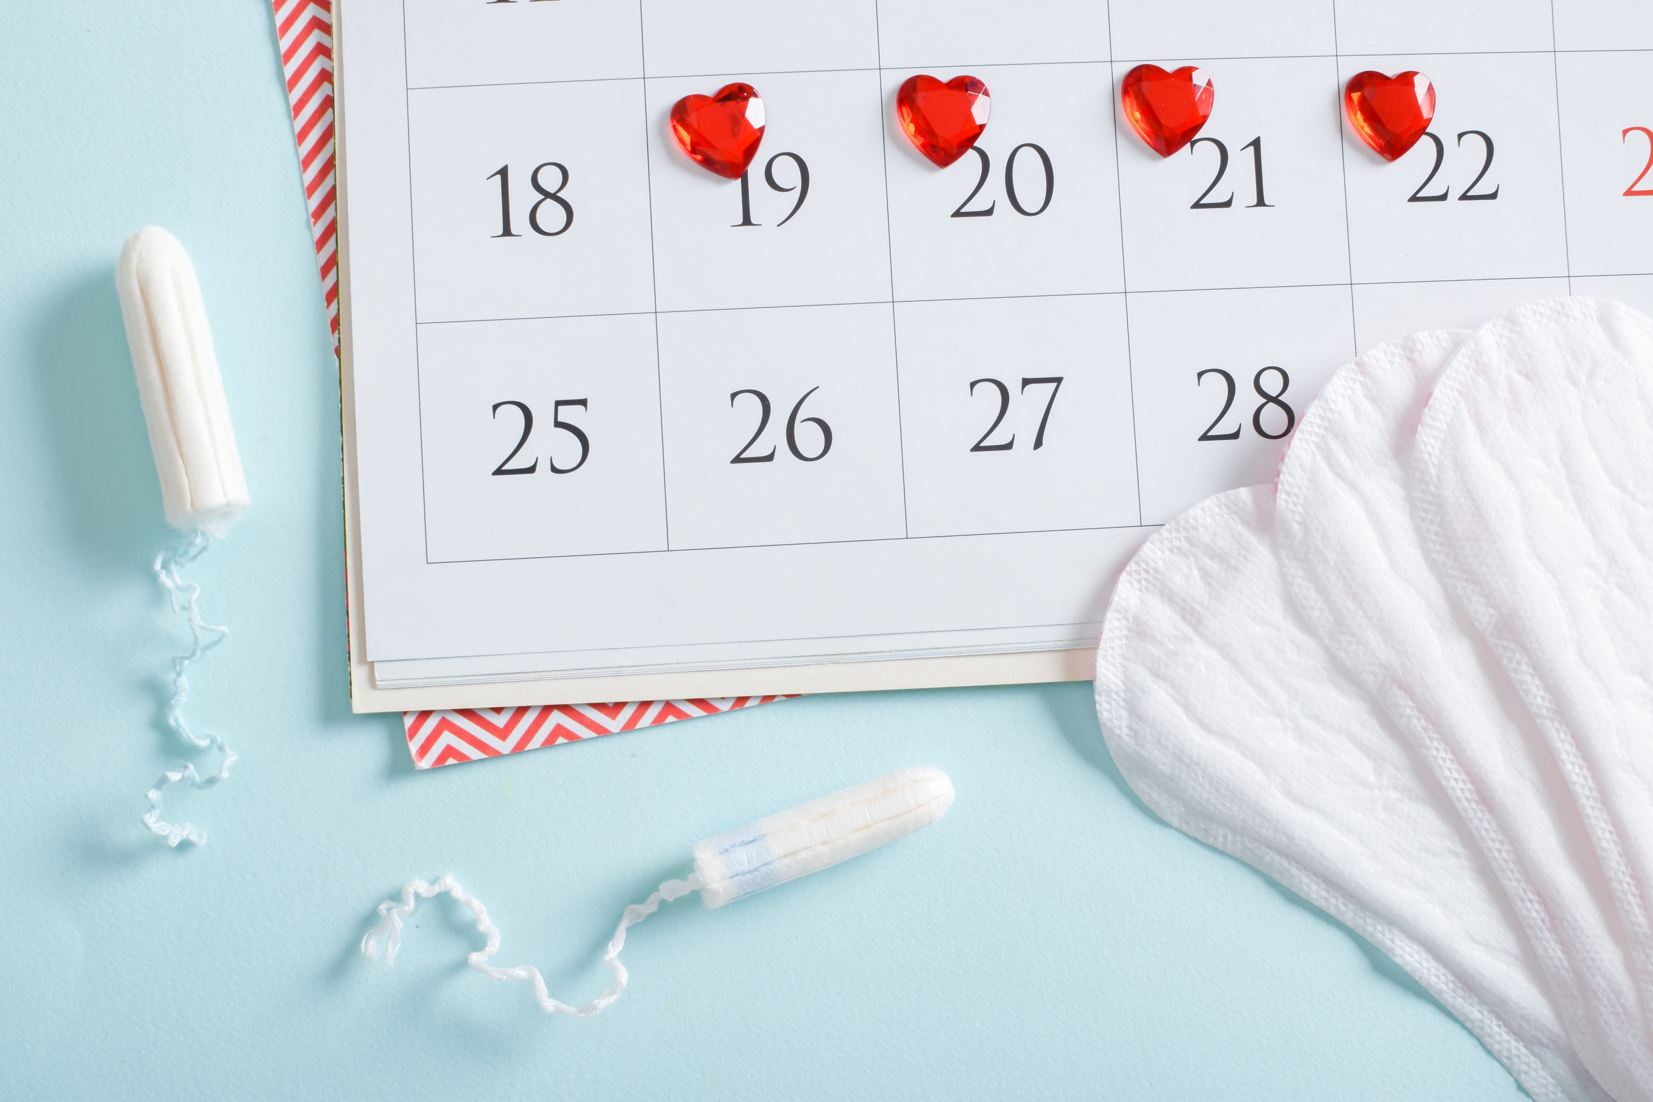
Dealing with periods at school
These issues may affect you at school:
Painful periods
Heavy periods
Unpredictable periods
Mood changes
Fatigue
Constipation/diarrhoea
Things to consider:
Period products in the toilets
If periods seriously affects your wellbeing – see your doctor and ask your school
for support
If you need to leave the classroom because of your period – you should
be allowed
Transmales, non-binary and gender diverse people may have periods
Notes:
Summarizing the menstrual cycle section, it is important for everyone to understand what it is like to have a period. It would be great if all schools could have free period products in the toilets and they should allow females out of the class when needed. Some people will be really unwell during their period and will need to take time off school and schools should support them through this. It is important that no one suffers in silence because of their period and if they have any concerns, they should see their doctor. Transmen may have a period and use the male toilets, so this needs to be considered.
Question – is there anything that school could do to support you with your period?

Slide 19

Fertility
Notes:
We appreciate that the following topics might seem a long way away for teenagers. Research shows that most young people want children in the future. We have several leaflets on topics relating to fertility. See our web site. We have also produced a poster listing 9 things people should know about fertility – which is available in various languages on our web site.
Questions:
Do you think you might want children in the future? Yes, No, Not sure
For those who want children, what age do you think you want to have children?
The average age most young people say, if they want to have children, is around age 30. There can be a discussion of what they would like to achieve in their lives before they want to start a family. And that having children is not the end of their life!

Slide 20
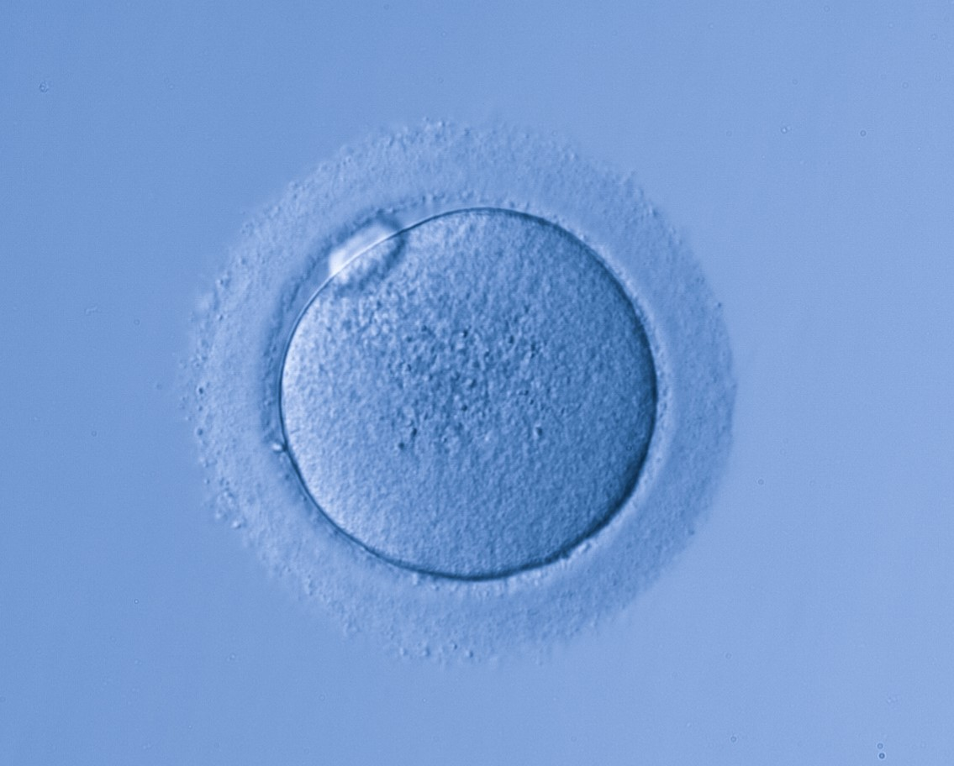
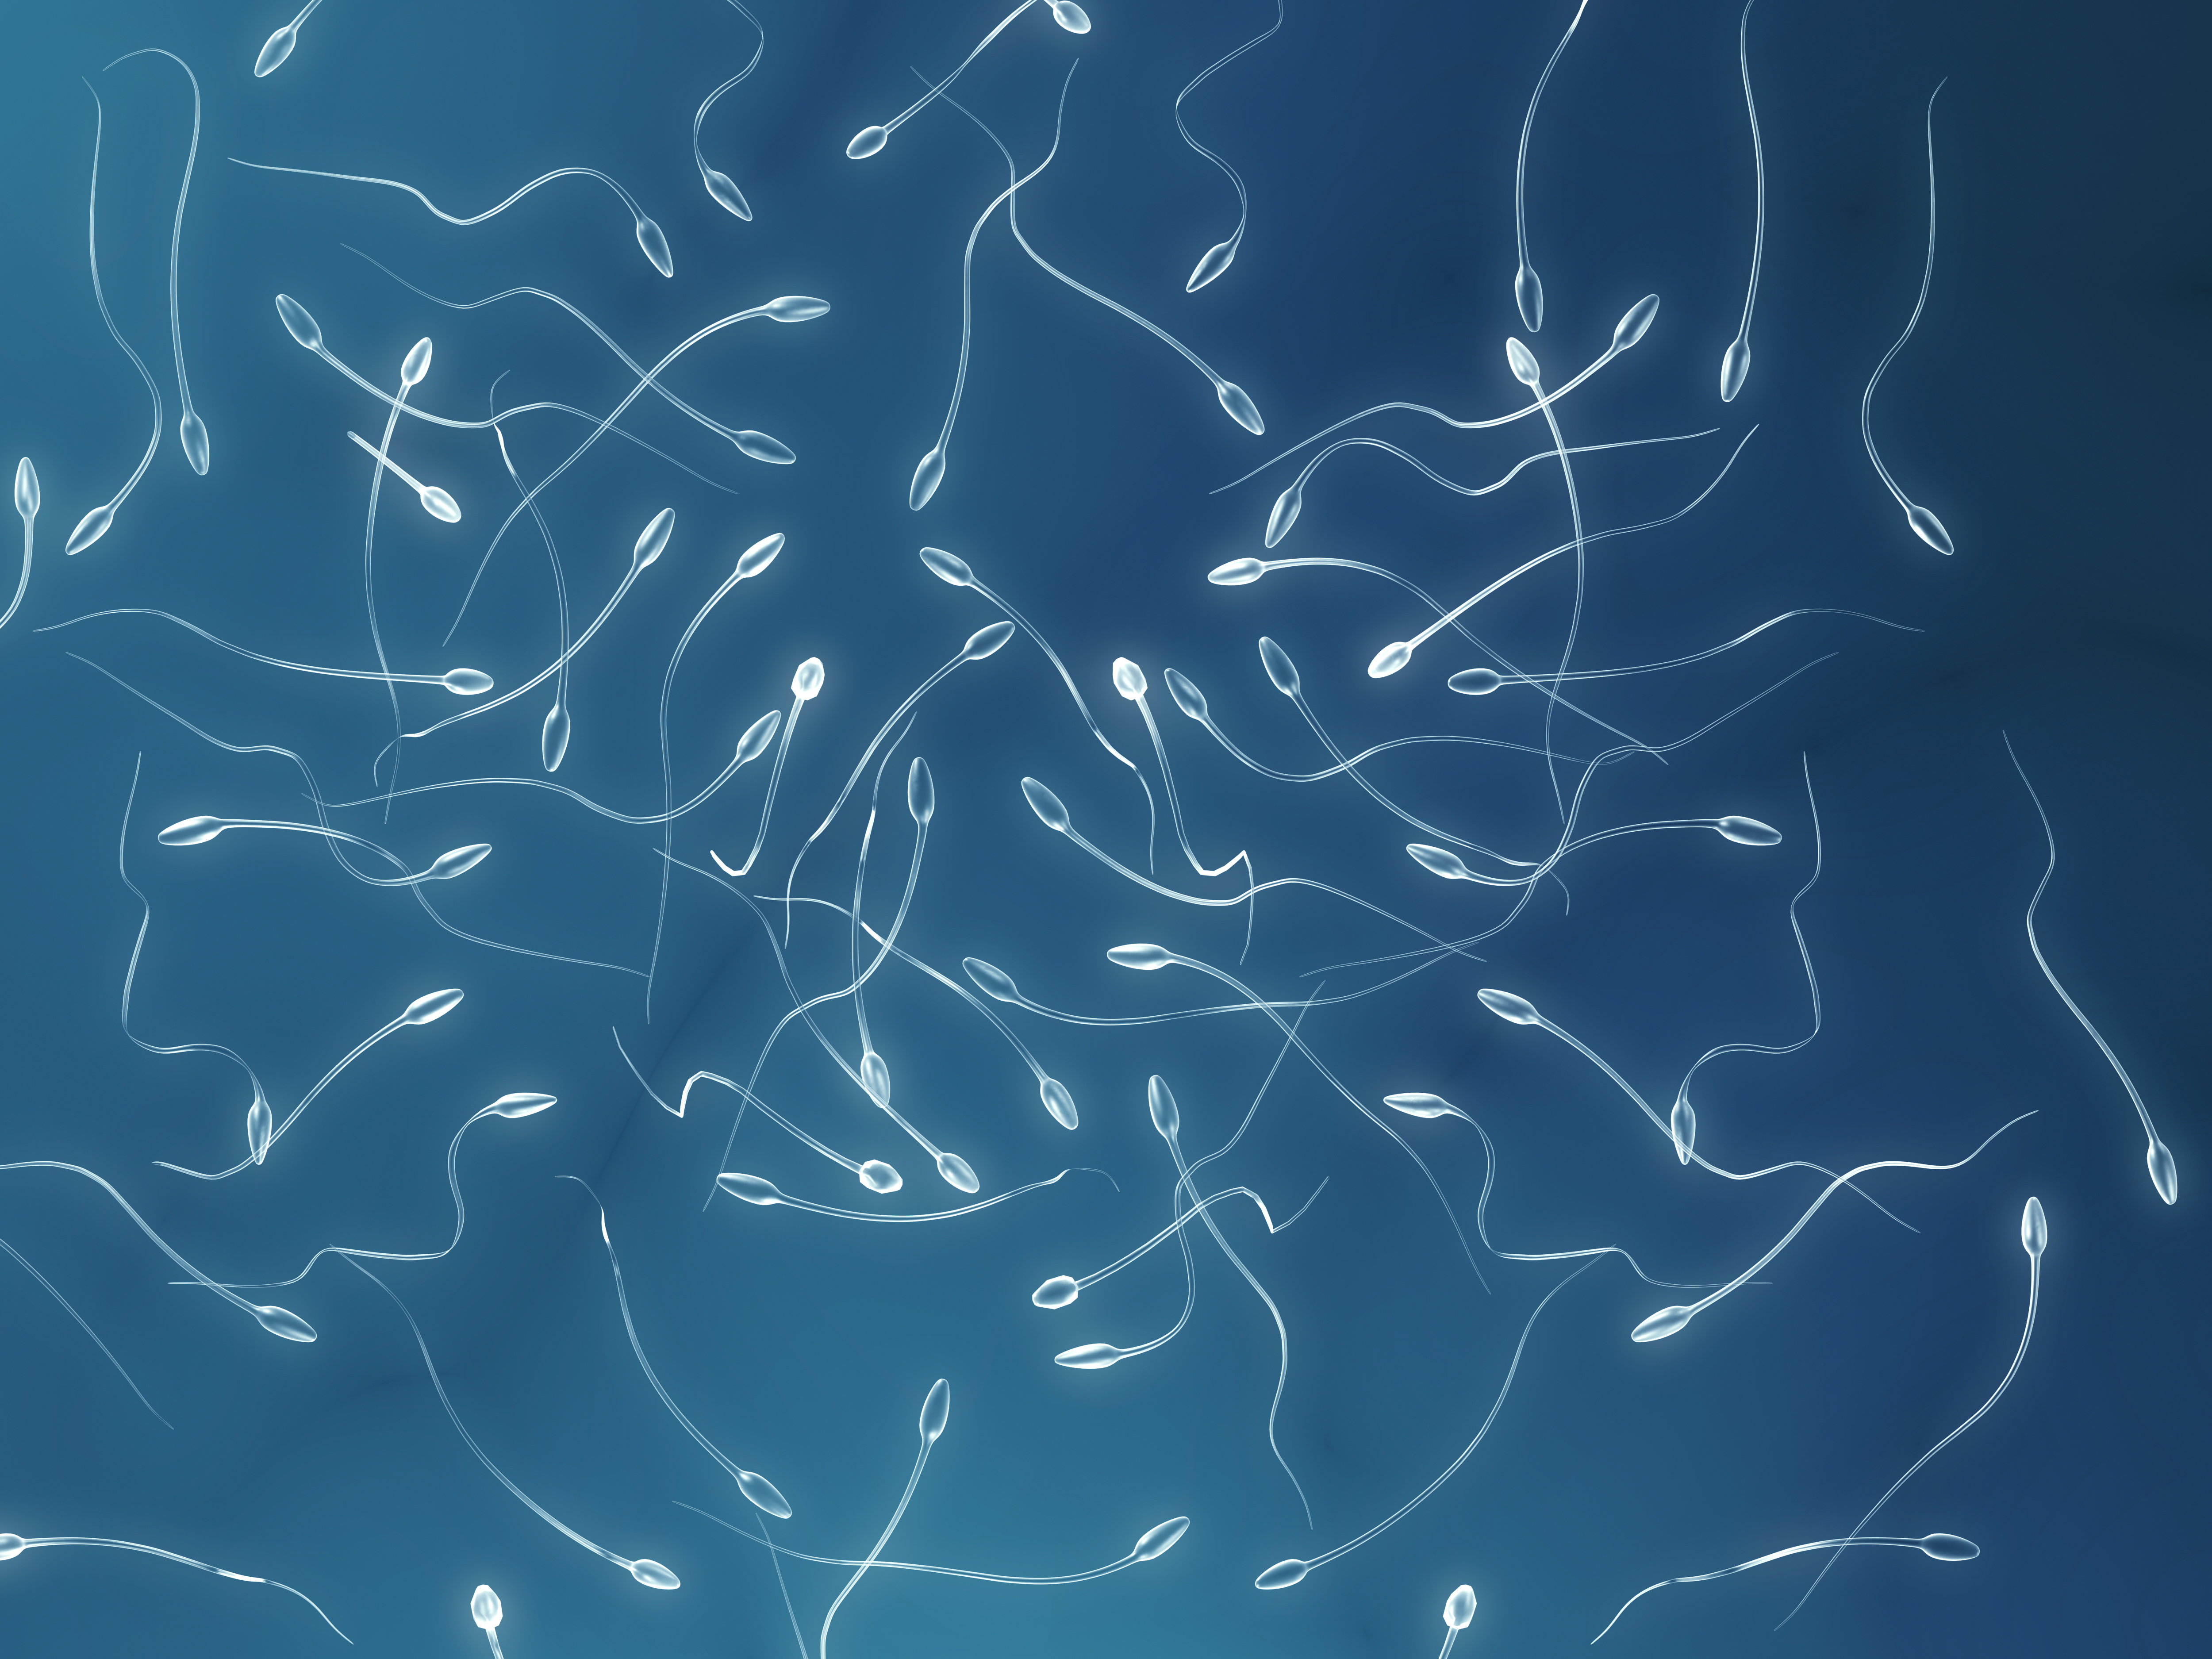
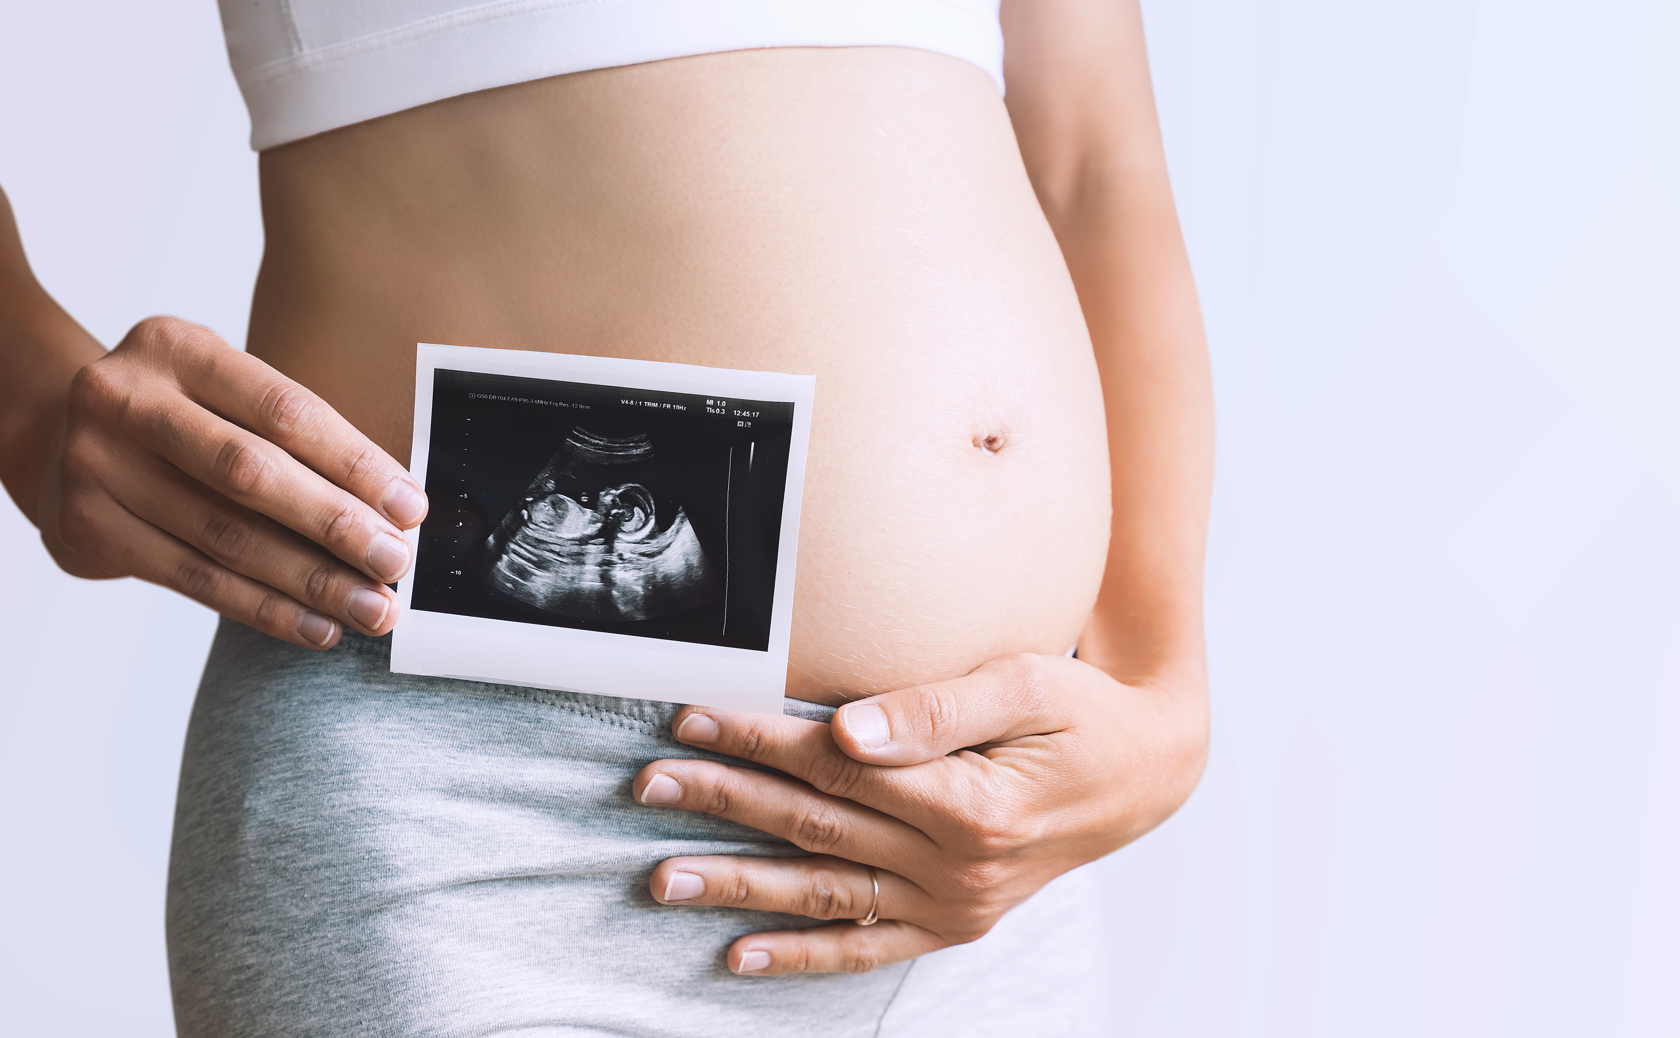
To make a baby
it takes an egg, sperm and a womb
1 egg per month
500 in lifetime
100 million sperm
per ejaculate
The baby
grows in the womb
Notes:
Females have up to about 500 menstrual cycles in their life so they ovulate about 500 eggs. Males produce about 100 million sperm per ejaculate. The fetus grows in the womb. Most people can have a baby when they try but about one in ten people experience infertility because of problems with their eggs, sperm or womb.

Slide 21
How to get pregnant or avoid pregnancy
If someone doesn’t want to get pregnant
If having sexual intercourse - it is essential
to use effective contraception at all times
This is especially true for teenagers – as they are
likely to be very fertile
When someone wants to get pregnant
The chance of pregnancy increases if you
have intercourse around the fertile window
Notes:
Looking at the hormones again – sexually active people spend their lives either trying to get pregnant or trying to avoid getting pregnant. The fertile window is around the time of ovulation – when the egg is released from the ovary.

Slide 22
Reproductive life plan
A reproductive life plan is about whether you want children or not, and making a plan for how to achieve your goal.
This plan may change during your life.
Spend a minute or two to think about
what is important to you.
Here are some questions you might want to think about
or discuss with teachers and friends:
Do you plan to have any (more) children at any time
in the future? If yes, how many and when?
What method do you plan to use to protect yourself against unwanted pregnancy?
How can you protect yourself and partner against
sexually transmitted infections?
What else can you do to preserve your fertility,
if you decide to have children?
What, if anything, do you want to change about
your health, relationships, home, school, work, finances,
or other parts of your life, before pregnancy?
What would you like to know more about?
Notes:
You may wish to discuss with the class if they think they might want children in the future? Probably most in your class will say yes. These questions can be discussed in class.
This is a short animation produced by the UK Fertility Education Initiative - https://www.youtube.com/watch?v=ETwDCKBaYd4

Slide 23
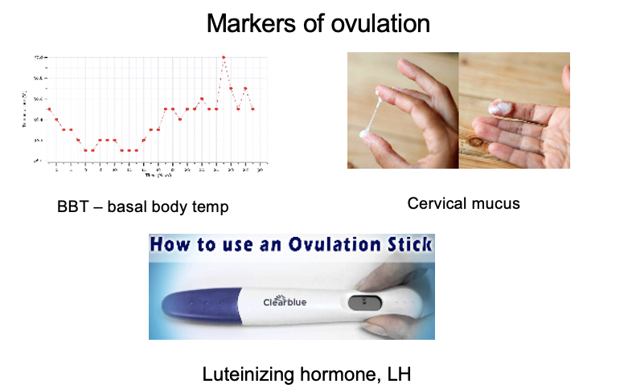
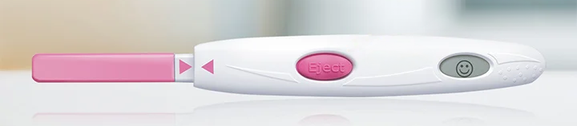
Markers of ovulation
The fertile window
6 days
Basal Body temperature
37,5
37,4
37,3
37,2
37,1
37,0
36,9
36,8
36,7
36,6
36,5
36,4
36,3
Pregnancy is most
likely to happen
from around 5 days before ovulation
until the day the
egg is released.
Having sex at this
time boosts your chance of pregnancy.
1
2
3
4
5
6
7
8
9
10
11
12
13
14
15
16
17
18
19
20
21
22
23
24
25
26
27
28
29
30
Cervical mucus
5 days before ovulation
Day of ovulation
Luteinizing hormone, LH
Notes:
Ovulation is when a mature egg is released from the ovary. The egg then moves down the fallopian tube where it can be fertilised. If sperm are in the fallopian tube when the egg is released, there is a good chance that the egg will be fertilised, creating an embryo, which can grow into a baby.
The highest chance of pregnancy is if you have intercourse during the five days before ovulation or on the day of ovulation. But the most fertile days are the three days leading up to and including ovulation.
There are two signs of ovulation: body temperature rises very slightly on the day of ovulation and the cervical mucus gets watery and slippery in the days leading up to ovulation. Ovulation sticks measures the rise in luteinizing hormone which happens about 24-40 hours before ovulation. These methods are useful when trying to get pregnant as they identify the fertile window.
Question:
Before telling the class, you can ask them why the fertile window is 5 days before ovulation. Usually, someone will know it is because the sperm can live in the female genital track for that long.

Slide 24
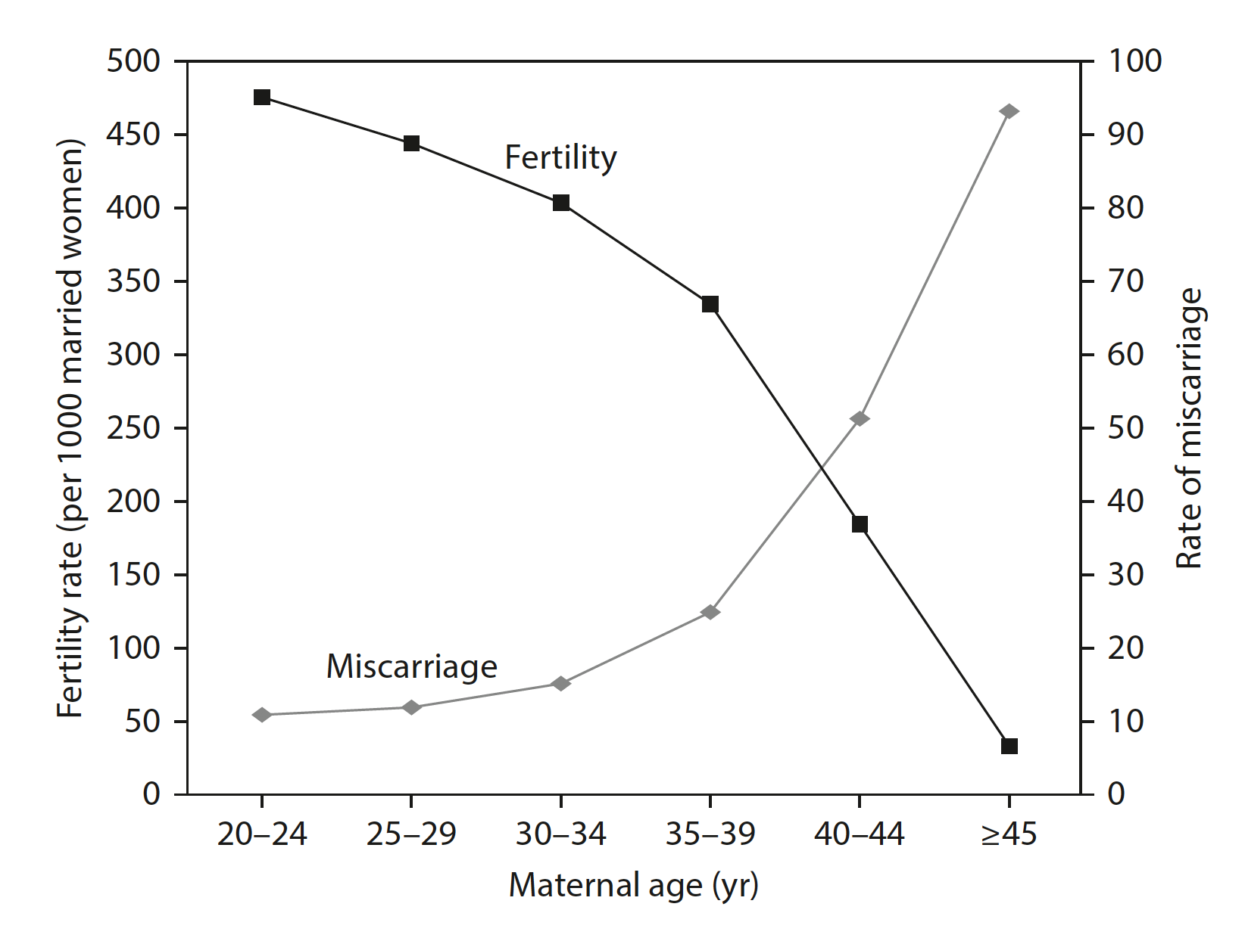
Female fertility is highest before age 35
The chances of getting pregnant drop significantly over age 35
Your fertile years
Quantity
Females are born with all
the eggs they will ever have
About 1-2 million potential eggs at birth
By puberty, 200-400,000
eggs left
The others have been reabsorbed by the body
From puberty – lose up to a 1000 each month
Menopause - all gone
Quality
Eggs have delicate chromosomes
With age there is an
Increased risk
of miscarriage
Increased risk
of chromosomally
atypical child
Decreased chance
of getting pregnant
Notes:
This graph shows that the chance of a baby is very dependent on the age of the female. It goes down rapidly after the age of 35 years and the risk of miscarriage goes up (we will come back to this). Young females are super fertile and should always use contraception if they have vaginal sex with a male. Female fertility is mainly dependent on the quantity and quality of eggs which both decrease with age. Most females will be unable to get pregnant about 5-10 years before they reach menopause. The average age of menopause is 51.

Slide 25
Males produce sperm throughout their lives
But the quality decreases after age 40
Males over 40 have
Fewer healthy sperm
Increased risk
of miscarriage
It takes longer to
get their partner pregnant
Obese or overweight males have fewer healthy sperm
Smoking, alcohol, vaping
and anabolic steroids reduce fertility
Testicular cancer may
lead to infertility
Notes:
Males produce sperm all their life but after age 40 the quality of their sperm and the chance of having a baby decrease. The evidence for alcohol and vaping affecting male fertility is limited but we felt it was important to discuss it. We are aware that some teenagers use anabolic steroids and this is an opportunity to discuss it further.

Slide 26
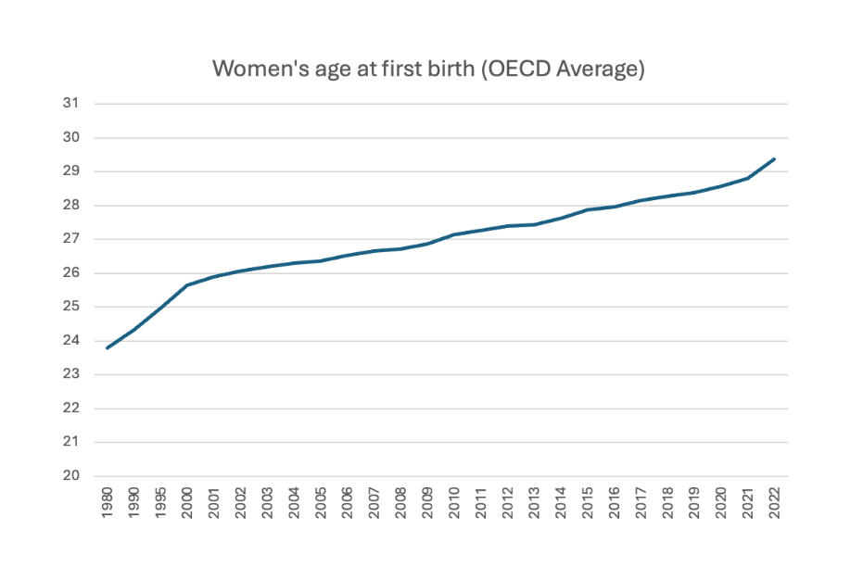
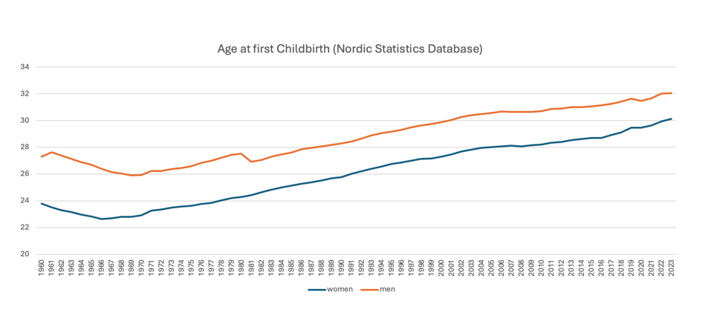
Mean age of females and males at birth of first child
Women’s age at first birth (OECD Average)
Men’s age at first childbirth (Nordic Statistics Database)
And people are having less children:
Total fertility rate in Europe is 1.46
Notes:
Globally, the age at which people are having children is increasing and in many countries the age of first birth is over age 30. So, this will give people a limited time to try to achieve their family. Research shows that most people want 2-3 children. The total fertility rate is the number of children a woman of fertile age has in each country. It decreases every year. 1.46 means people are having 1.46 children which is less than most people want.

Slide 27
There’s more than one way to have children
Single people and/or LGBT+ couples may need to go through fertility treatment
Always if donor eggs are needed (single men, same sex male couples)
Ideally if donor sperm is needed,
as this ensures medical and legal issues are dealt with,
but there are other ways to obtain sperm (single women and same sex female couples)
Surrogacy may be needed (single men and same sex male couples)
There are regulations about these procedures
in different countries
Adoption and fostering are also options
Notes:
Single and LGBT couples can have children. The Science Museum did a webinar about the future of sex and how LGBT people can have a family which can be found at https://www.youtube.com/watch?v=66UFkHRIsCU.
Single and same sex males need eggs and a womb
Single and same sex females need sperm
Trans people had individual needs depending on their transition and their partner. There is some more information on the next slide.

Slide 28
Fertility for people who do not identify
as their sex at birth
Fertility preservation is an option
if medically transitioning
Hormones and/or surgery can
cause infertility
Those who produce eggs –
can freeze eggs
  May or may not wish to keep having periods
  If they keep their womb –
  they may or may not wish
  to be pregnant
Those who produce sperm –
can freeze sperm
But eggs and sperm need
to be frozen before any
medical transition
Taking testosterone
may or may not
stop a period
And may or may not
make you infertile
You can still get
pregnant if having penis/vagina sex
Notes:
People who transition from male to female or from female to male can preserve their fertility by freezing their eggs/sperm. Those who produce eggs, can freeze their eggs and may or may not wish to have periods or be pregnant. Those who produce sperm can freeze their sperm. Transmen or non-binary who have taken male hormones and have unprotected vaginal sex can become pregnant unexpectedly. Advice about contraception is important for this group.

Slide 29
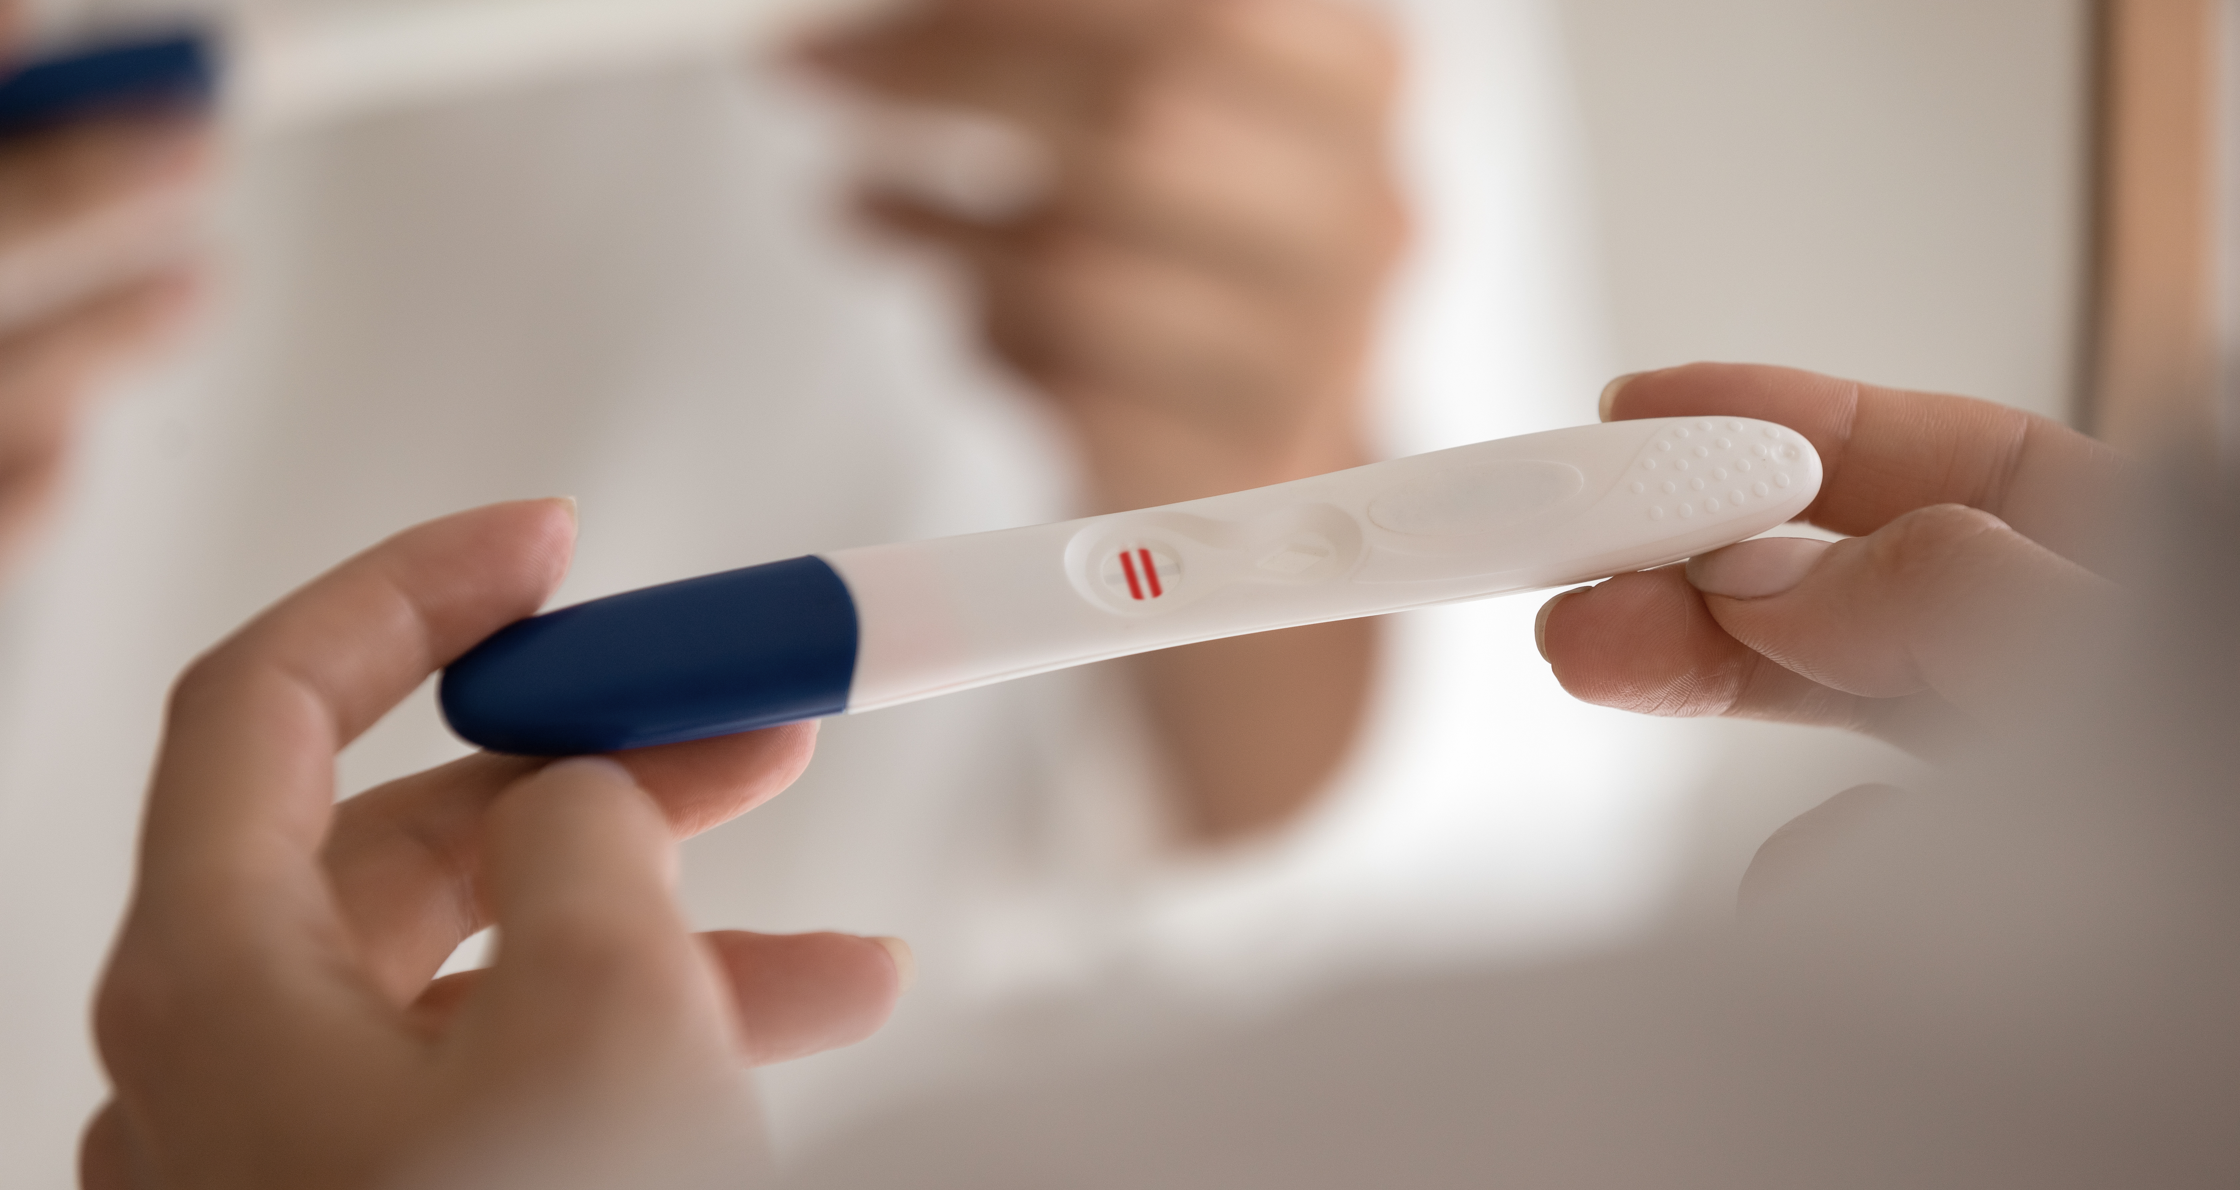
If you get pregnant and do not want to be pregnant
Where to get help and advice
If you get pregnant,
three options:
  Parenting
  Abortion
  Adoption
Speak to:
Family
Friends
Doctor
Contraception or
sexual health clinic
Notes:
Teenagers who become pregnant should speak to someone as soon as possible to discuss what they want to do. In the contraception section we explain about emergency contraception if they have had unprotected sex.

Slide 30

Fertility
take home messages
When you want to get pregnant, you increase your chances if you have sex during the fertile window
Males are relatively fertile their whole lives, but there are issues to consider for older fathers
Female fertility
declines from about
age 35, males from
age 40
LGBTQ+ fertility awareness. Especially important if medically transitioning
Notes:
A recap of the key messages for fertility.

Slide 31
Contraception
Notes:
Most schools cover contraception and STIs so here we have briefly made some key points. Please let us know if you would like us to expand these slides.

Slide 32


If you don’t want to get pregnant
It is essential to use contraception
every time you have sex
If you are taking the contraceptive pill,
you need to take it every day it is required
You are super fertile in your
teenage years
There are many methods
This web site has a lot of information
www.contraceptionchoices.org
Notes:
Young people are super fertile and they must be aware that their chance of getting pregnant is very high if they don’t use adequate contraception. University College London have made an interactive web site to teach about contraception – www.contraceptionchoices.org.

Slide 33
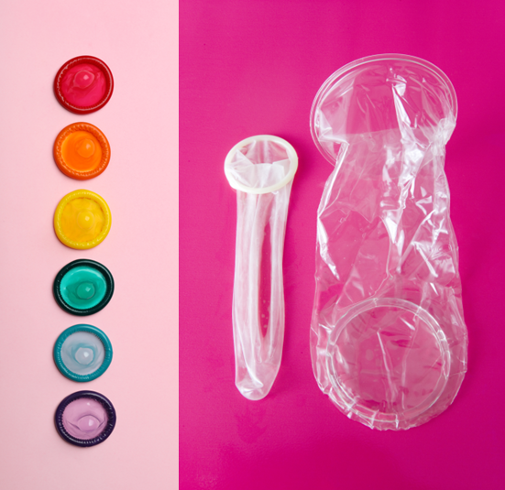
Barrier methods of contraception
prevent pregnancy and STIs
Male condom
Female condom
Essential to wear throughout sexual intercourse
Sperm can leak from the penis before ejaculation
This is why the withdrawal method is ineffective
If a condom breaks, it is recommended to use emergency
contraception as there is still a chance of pregnancy
Notes:
Some key aspects to consider about condoms.

Slide 34
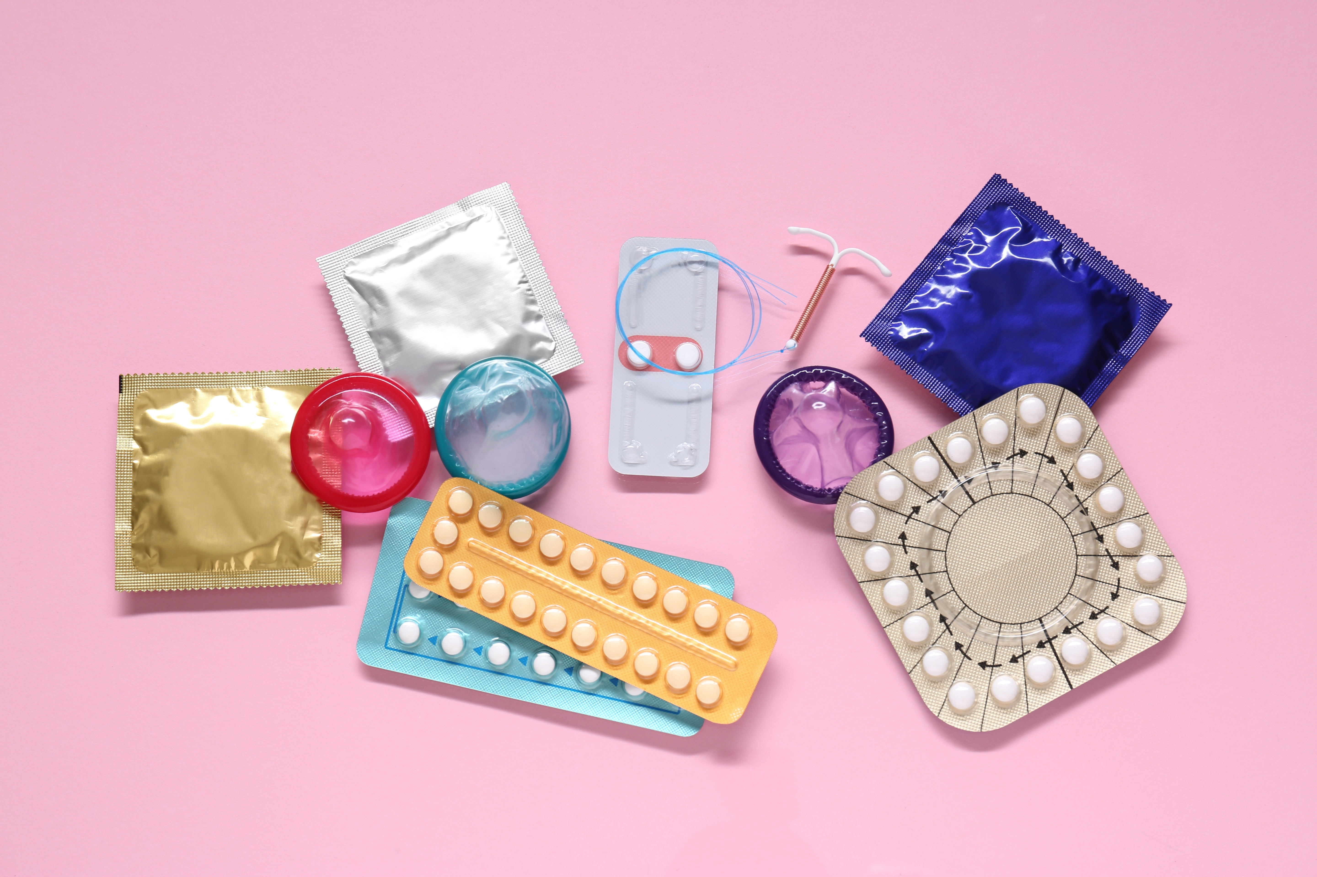
Other types of contraception
Hormonal methods
Combined hormonal pill
Contraceptive patch
Vaginal ring
Progestogen-only pill
(the mini-pill; POP)
Contraceptive implant and contraceptive injection
Intrauterine systems (IUS)
Non-hormonal methods
Intrauterine device (IUD)
Diaphragm and cap with
spermicide
Emergency contraception
Can be used after unprotected sex
or if another contraception method
has failed, such as the condom splitting
or forgetting to take a pill
There are two types – a pill or an
intrauterine device
It must be used as soon as possible
after unprotected sex – the sooner it is used,
the higher the chance of it working
It is not recommended to use this
on a regular basis
Notes:
A short summary of other types of contraception.

Slide 35

Sexually transmitted infections (STIs)
Notes:
Most schools cover contraception and STIs so here we have briefly made some key points. Please let us know if you would like us to expand these slides.

Slide 36
Sexually transmitted infections
STI
Four STIs
caused by bacteria/parasites
Trichomoniasis
Chlamydia
Gonorrhea
Syphilis
Four STIs
caused by viruses
Human papillomarvirus (HPV)
Herpes simplex virus (HSV or herpes)
Hepatitis B
Human immunodeficiency virus (HIV)
Notes:
Further discussion about all of these STIs is advisable.

Slide 37
HPV vaccine
What does the
HPV vaccine
protect against?
The 9 strains of HPV
that cause most cases
of cancer
Mouth, throat and genital cancers
90% of cases of cervical cancer
90% of cases of genital warts
HPV vaccine helps protect against HPV
Recommended for children aged
12 to 13 years old
Greatly reduces the risk of developing
genital warts, and cancers that affect
the cervix, the penis, the anus, the mouth
and the throat
HPV vaccination
Notes:
If your school gives the HPV vaccine, you have probably covered this but it might be useful to recap.

Slide 38

Infertility
Notes:
We have produced some information leaflets about fertility and infertility which are on our web site. There may be some of your class who are born from fertility treatment.

Slide 39

Incidence of infertility
Most couples having regular sex will be pregnant within a year
of trying
But 1 in 6 couples experience infertility
If this happens – need
to see a fertility expert
There are various types of experts:
Gynaecologist
looks after female reproductive health
Andrologist
looks after male reproductive health
Embryologist
works in the fertility clinic laboratory and
looks after the eggs, sperm and embryos
Midwife
helps monitor the pregnancy and deliver
the baby
Notes:
Usually, some infertility treatments are covered in schools so we have not gone into this in a lot of detail. But if teachers want further information, please contact joyce.harper@ucl.ac.uk. The incidence of infertility varies globally – you might want to discuss what it is for your country.

Slide 40
Possible causes of female infertility
Ovulation
missing fertile window, not ovulating, egg quality/quantity, hormone problems, PCOS
Fallopian tubes
blocked, usually infection
Endometriosis
scar tissue, prevents egg and sperm meeting
Uterus/cervix
fibroids, infection, polyps
Some females experience premature ovarian failure –
they run out of eggs very early.
Poor nutrition including
drinking too much alcohol
Smoking or vaping
Obesity or being underweight
Psychosexual problems
Genetic factors
In some cases,
the cause is unknown
Causes of infertility
Female factor
40%
Male factor
40%
Unexplained
20%
Notes:
This is a brief outline of the possible causes of female infertility. We have information leaflets on this topic. Later we talk about lifestyle in more detail and how this can affect reproductive health. See the slides on wellbeing.

Slide 41
Possible causes of male infertility
Sperm count and quality:
may be low count or no sperm,
may be poor quality
Factors that may affect sperm: undescended testes, cancer, varicocele (dilated veins in the scrotum), some STIs
Use of anabolic drugs/steroids:
may cause infertility
Poor nutrition including
too much alcohol
Smoking and vaping
Obesity
Anabolic steroids
Psychosexual problems
Genetic factors
In some cases, the cause is unknown
And some jobs such as those where there is exposure to high temperature or certain chemicals
Causes of infertility
Female factor
40%
Male factor
40%
Unexplained
20%
Notes:
This is a brief outline of the possible causes of male infertility. We have an information leaflet about this. Later we talk about lifestyle in more detail and how this can affect reproductive health. See the slides on wellbeing.

Slide 42
Prevention of infertility for both partners
If you want to protect your fertility
Maintain a healthy body weight
Weighing too much or too little can not only put your health at risk, but also can diminish your fertility
Eat a healthy diet
Keep alcohol consumption low
Have regular exercise
Don't smoke or vape
Don’t have unprotected sex to reduce the risk
of STIs
When you're ready to have children,
don't delay
Understand when is the best time
to have sex to get pregnant
Notes:
Infertility can be caused by problems with the male, the female, both or be unknown. The main causes of infertility are listed.
Later we talk about lifestyle in more detail and how this can affect reproductive health. See the slides on wellbeing.

Slide 43
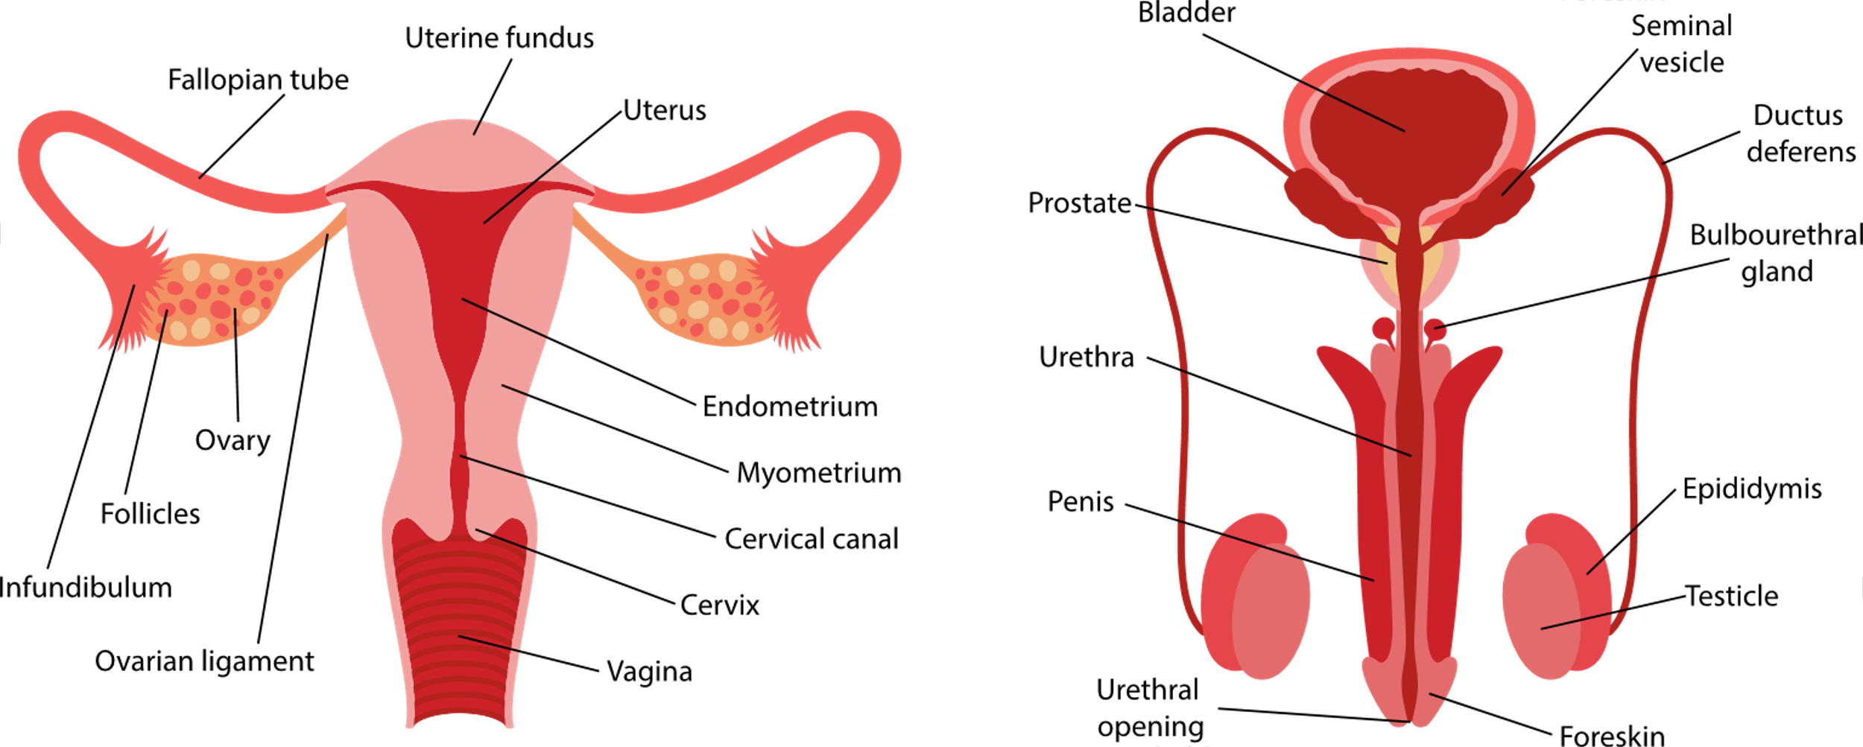
Fertility tests
There are no tests that can say how fertile you are
But there are tests that can be used to determine if something is wrong
Usually these will only be done after you have been trying to get pregnant for
1 year
Males
Sperm count
Hormone checked
Physical examination
Females
Hormones checked
Fallopian tubes checked
Womb checked
Womb
Notes:
It will be useful for students to know about fertility/infertility tests. There is heavy marketing of tests that claim to test fertility but there is no evidence that they are useful. Heterosexual couples who have tried for a baby for 12 months or more and not got pregnant should see a doctor who will order tests to determine the reason why they have problems.
In males, a sperm count check is relatively easy. They may also have their hormones checked and have a physical examination of their testicles. If males find any lumps or anything unusual – they should see their doctor. For females, they may have their hormones checked, and tests done to check their womb and fallopian tubes. For both males and females, these tests are not usually done until they have been trying for a year without success. Doing them earlier than this can be unhelpful as things change and both partners need to be examined.

Slide 44
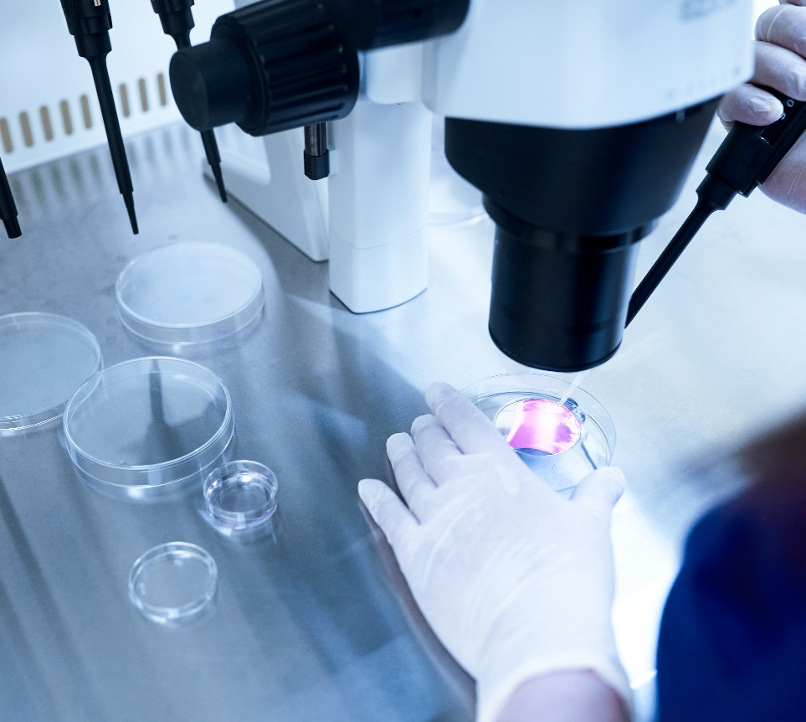
Fertility treatments
Fertility drugs
Ovulation induction
and timed intercourse
Intrauterine insemination (IUI)
In vitro fertilisation
(IVF)
Intracytoplasmic
sperm injection (ICSI)
Embryo freezing
Egg and sperm freezing
Egg and sperm donation
Embryo donation
Surrogacy
Notes:
This is a list of fertility treatments which can be used for medical or social infertility (social infertility includes same sex or single people who want children and might not have a medical reason but need treatment). We do not expect teachers to know all of these but we know some exam boards include IVF, so please feel free to edit this information or check the information leaflet on fertility treatments on our web site. There are regulatory differences between countries around the use of donor sperm, donor eggs and surrogacy that might be a good discussion point.

Slide 45
Intrauterine insemination
The Fallopian tubes need to
be open
Usually the female is given some fertility drugs to improve her chances of ovulation
When she is about to ovulate
the sperm is prepared in the laboratory
it is inserted into the
womb (uterus)
Indications:
unexplained infertility
endometriosis
reduced sperm quality
infertility in the male partner, when using donor sperm
single women or lesbian couples who wish to become pregnant using donor sperm
Notes:
This is often the first treatments used but the Fallopian tubes need to be open.

Slide 46
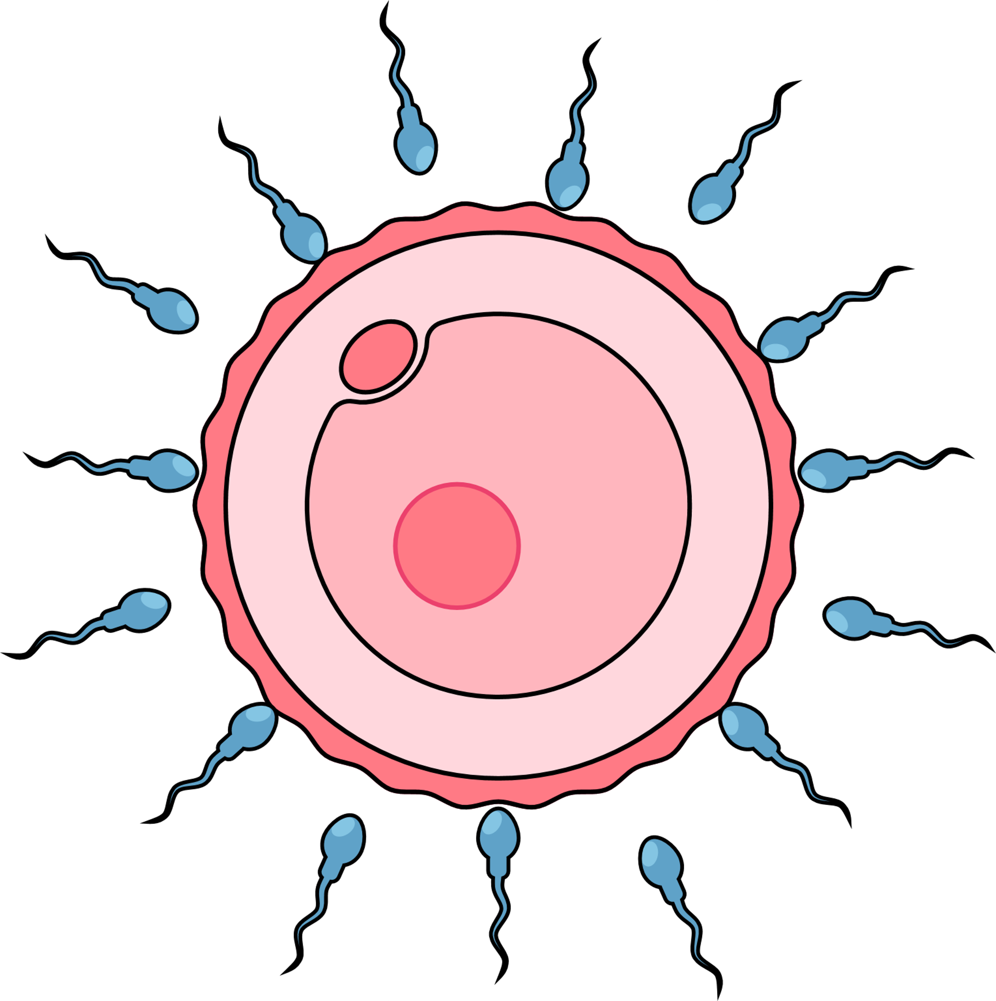
In vitro fertilization (IVF)
The female takes medication
to help her ovaries produce
about 8-12 mature eggs
On the day of the egg collection,
the doctor uses a needle to
remove the mature eggs
from the ovary
The eggs are stored in
the laboratory
The sperm is prepared and
mixed with the eggs
The embryologist monitors
to see if the eggs fertilise
to make an embryo
Usually only one embryo
is transferred to the womb
Indications:
blocked Fallopian tubes
ovulation disorders
endometriosis
unexplained infertility
Notes:
IVF is commonly used. We have produced an information leaflet on IVF

Slide 47
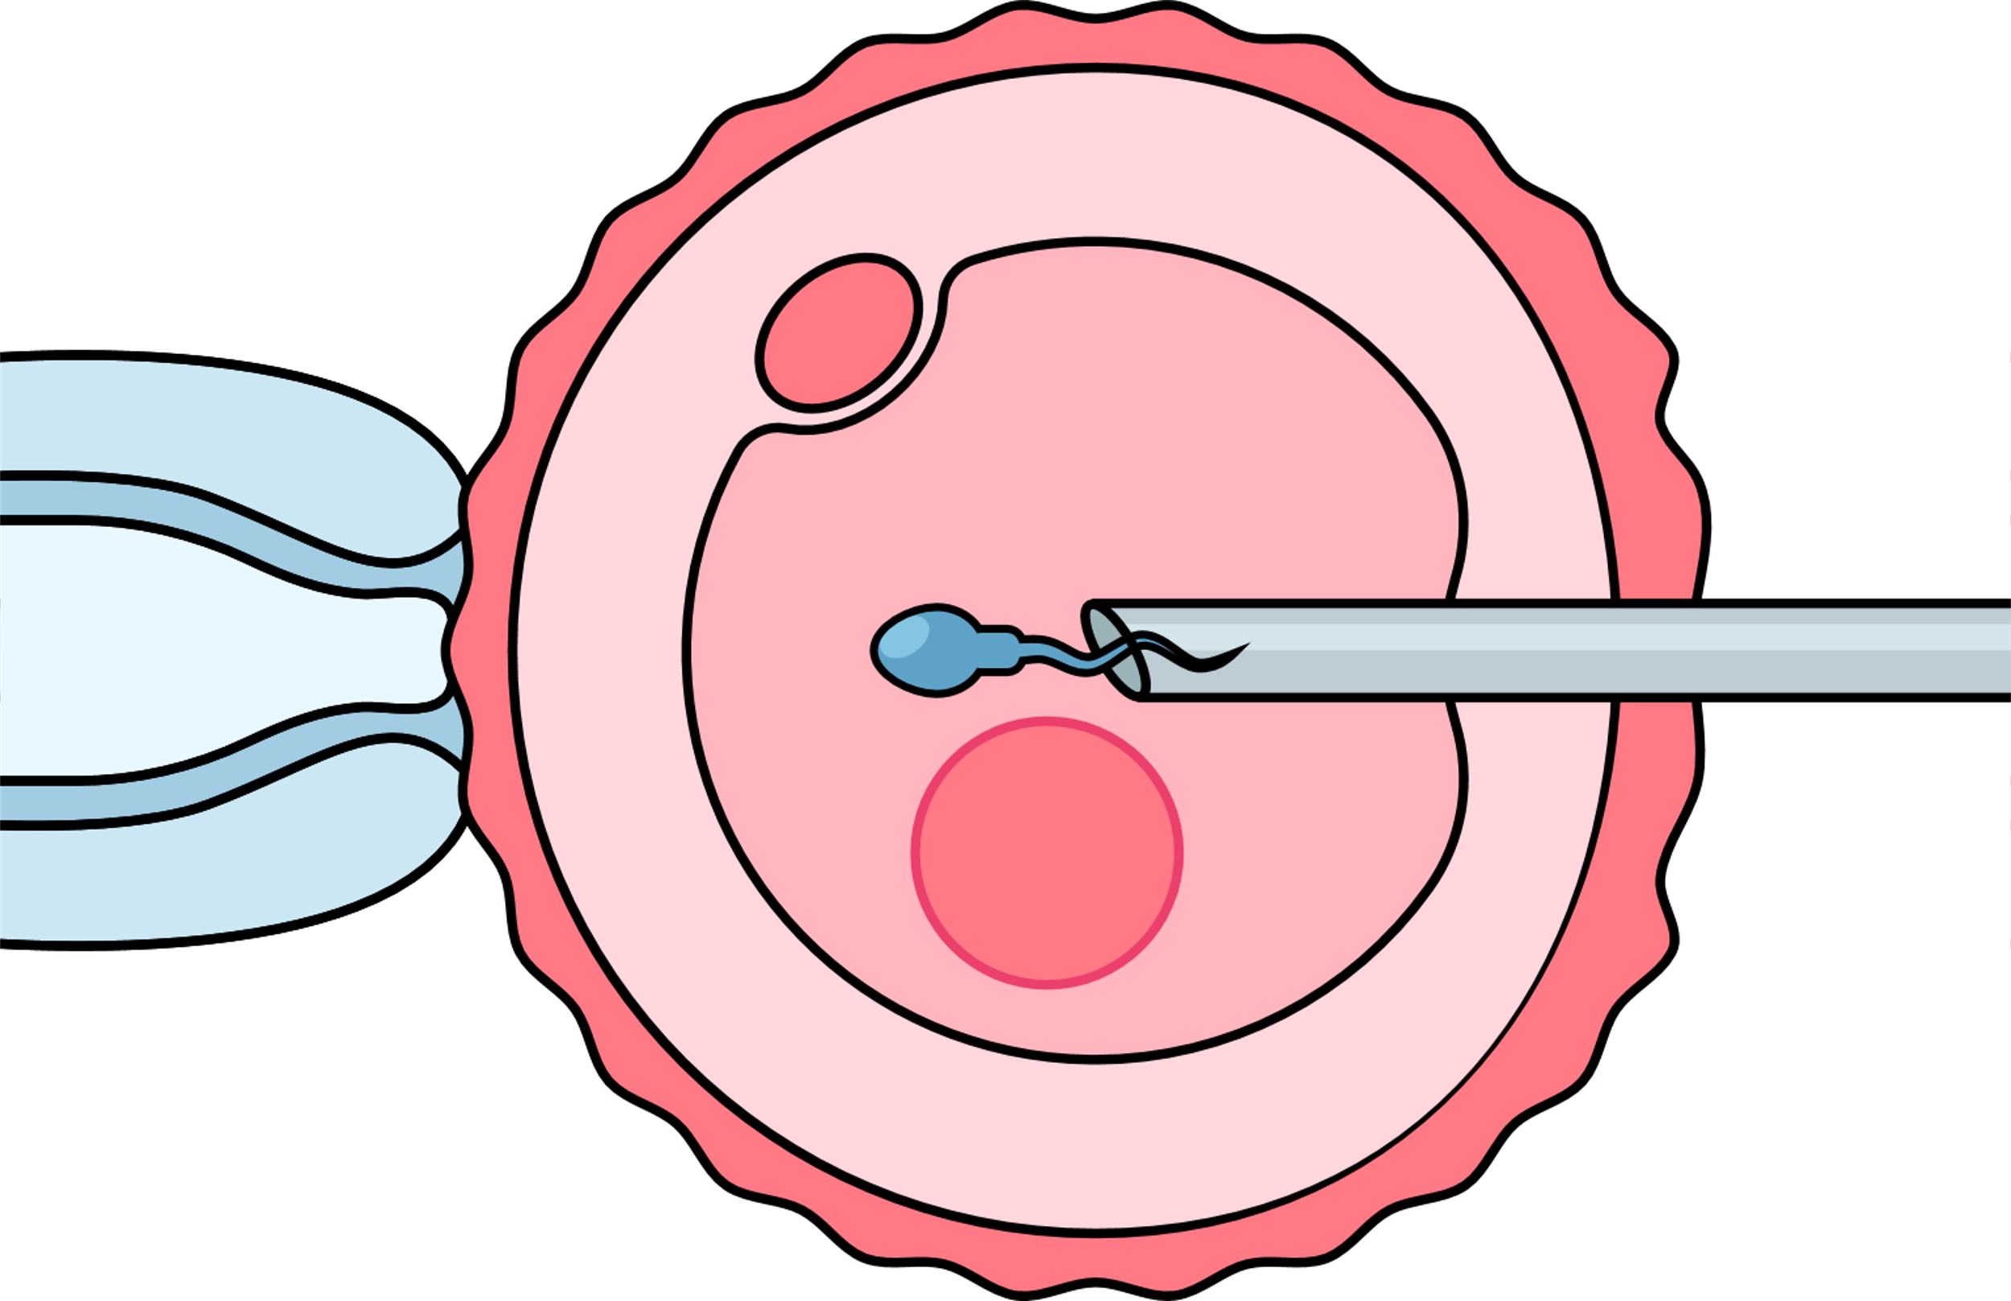
Intracytoplasmic sperm injection (ICSI)
This is almost identical to IVF except for the way
the sperm is introduced to the egg
In ICSI – the embryologist picks up one sperm in
a fine needled and injects it into an egg
Indications
Male factor infertility
Previous failure to make embryos
Notes:
ICSI is almost identical to IVF – the only difference is how the eggs and sperm are mixed. We have an information leaflet on ICSI. There are lots of videos on YouTube that can be used to show this.

Slide 48
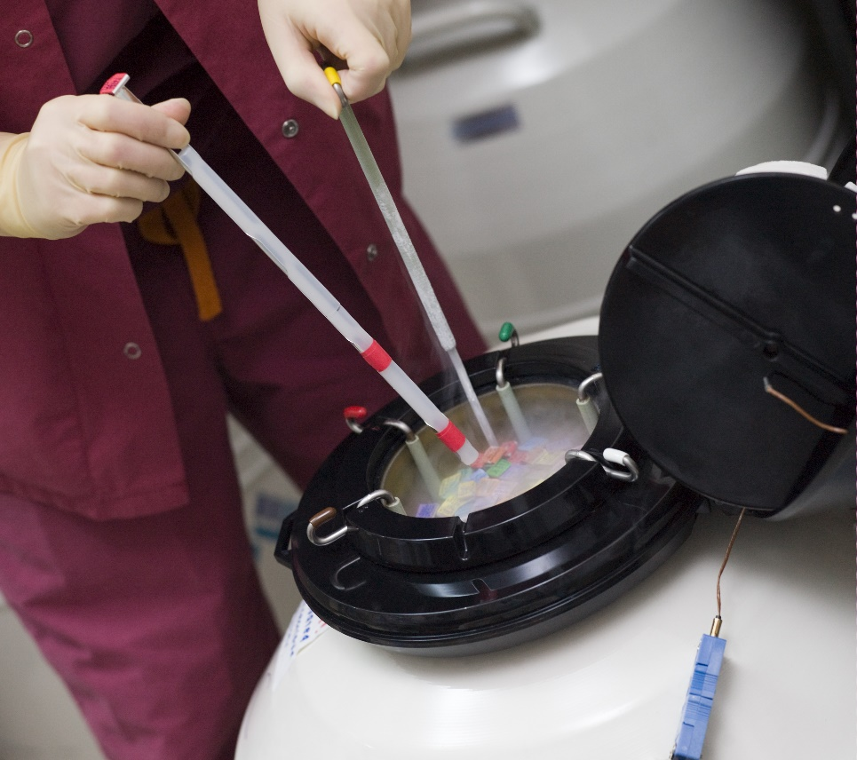
Embryo freezing
After IVF and ICSI, there may
be embryos remaining
If they are of good quality,
they can be frozen and transferred in another cycle
This is useful if the original
IVF or ICSI did not work
Or it was successful and
can be used to try for
a second baby
It saves going through
the whole IVF/ICSI procedure
again
Notes:
This is a very common procedure. It saves the couple going through IVF or ICSI again. They can have the embryos back in a natural cycle or some drugs can be given to build up the womb lining.

Slide 49
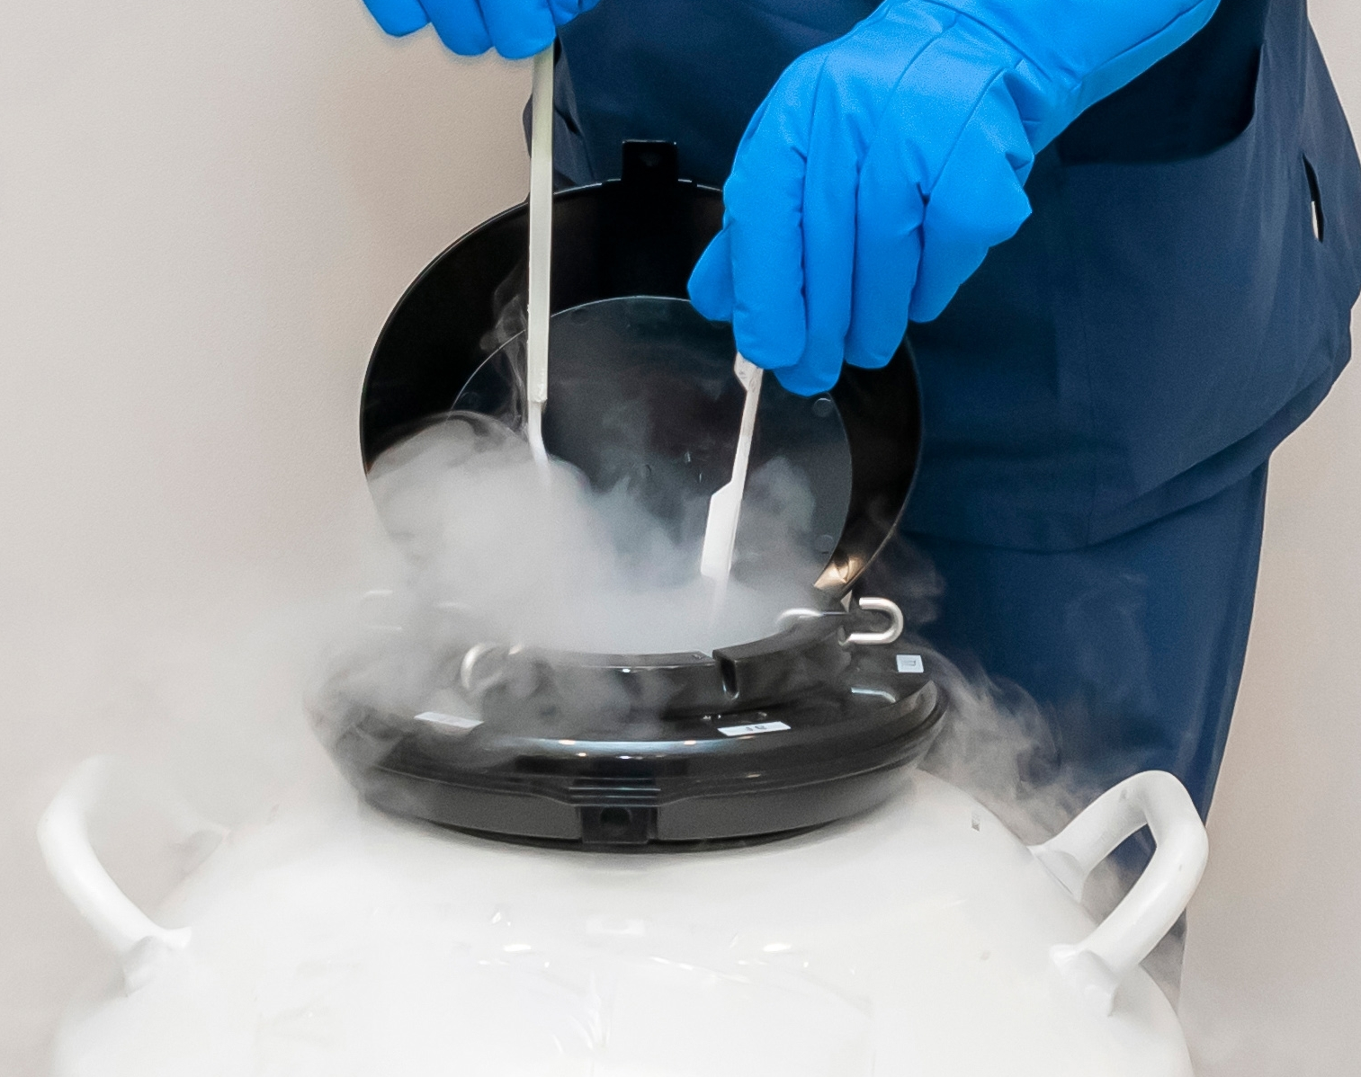
Is egg freezing the answer for female fertility decline?
If freeze eggs when younger,
they can be used when older
BUT:
No guarantee of a baby
It is expensive
Usually need more than one round of treatment
Regulations in some countries
Notes:
Egg freezing is a hot topic. It’s advertised as a way to put fertility on hold. But it is expensive, and there is no guarantee of a baby down the track. Data shows that most females do not come back to use their frozen eggs and some females may choose to try to get pregnant naturally before they use their frozen eggs. If a females uses them, she will be embarking on IVF. We have an information leaflet on egg freezing.
There is research into using stem cells to make eggs and sperm – if this works it will totally change the problems with male and female infertility, but we have no idea when this will be available.
Question: Why do you think females might want to freeze their eggs?

Slide 50
Sperm/egg donation and surrogacy
Sperm and egg donation
Rules vary between countries.
Limited number of children
Paid or not paid
Anonymous or known depending on the country
Sperm donors
Ideally via a clinic
They look after the medical and legal issues
Donor has to be aged 18-45/50
Egg donors
Has to be via a clinic as need an operation
Donor has to be aged 18-35
Surrogacy
A female carries a baby for another
Two types:
Traditional
a woman gives her eggs and carrries the baby in her womb
for someone else, so she is the genetic mother
Gestational
eggs from another woman are fertilised and the surrogate carries
the baby in her womb for someone else, so is not the genetic mother
Egg or sperm of couple or donation
Do not usually get paid in most countries
But may get reasonable expenses
Legally complicated
Notes:
Donor eggs and sperm can be used if a couple’s egg and sperm are not working. The slide summaries the way they are used. Surrogacy may be used if the female’s womb is not working. The age that donors need to be to donate varies in different countries. It is possible that someone in your class was born as a result of sperm or egg donation. We have information leaflets on donation.
Questions: What do you think about using donor eggs and sperm to make a baby?
What considerations need to be taken into account regarding surrogacy?

Slide 51
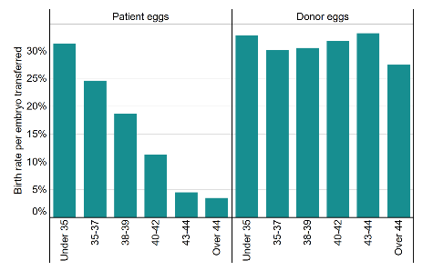

IVF success is mainly down to the age of the female
Pregnancy rate goes down with female age, significantly over age 35
Egg donors are usually under the age of 35
Age of the woman
Notes:
The success of IVF in the UK is shown here but it is similar data for most countries. In the UK, IVF is governed by the Human Fertilisation and Embryology Authority (HFEA). The graphs show the chance of birth by age. On the patients’ own eggs graph we can see the HFEA groups everyone under 35 together as their chances are similar but after age 35 they use 2-year or 3-year age ranges as the success goes down rapidly. But if a donor egg is used, the chance of birth stays around the same as all egg donors are under age 35. The womb stays relatively fertile – so it is all about the egg.

Slide 52
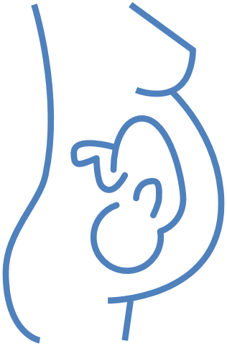
Pregnancy
Notes:
The main points of pregnancy will be discussed.

Slide 53


Preconception care
looking after your health before you get pregnant
For both partners
It is important that people start living healthy when they want to become parents
A healthy lifestyle creates a healthy environment for the baby to develop
People should eat healthy food,
stop smoking and stop drinking
alcohol, be physical active
Maintain a healthy weight and
take a folic acid supplement
Eat healthy
food
Be physical
active
Maintain
healthy weight
Take Folid Acid
supplement
Stop
smoking
Stop drinking
alcohol
Notes:
It is important for males and females to try to be as healthy as possible before they try to get pregnant – this is called preconception health. There are things people can do to improve their chance of pregnancy and giving the baby the best start in life. This includes eating a healthy diet, exercising regularly, trying to be in the healthy weight range, not smoking, and avoiding alcohol and recreational drugs. This is discussed again in the wellbeing section.

Slide 54

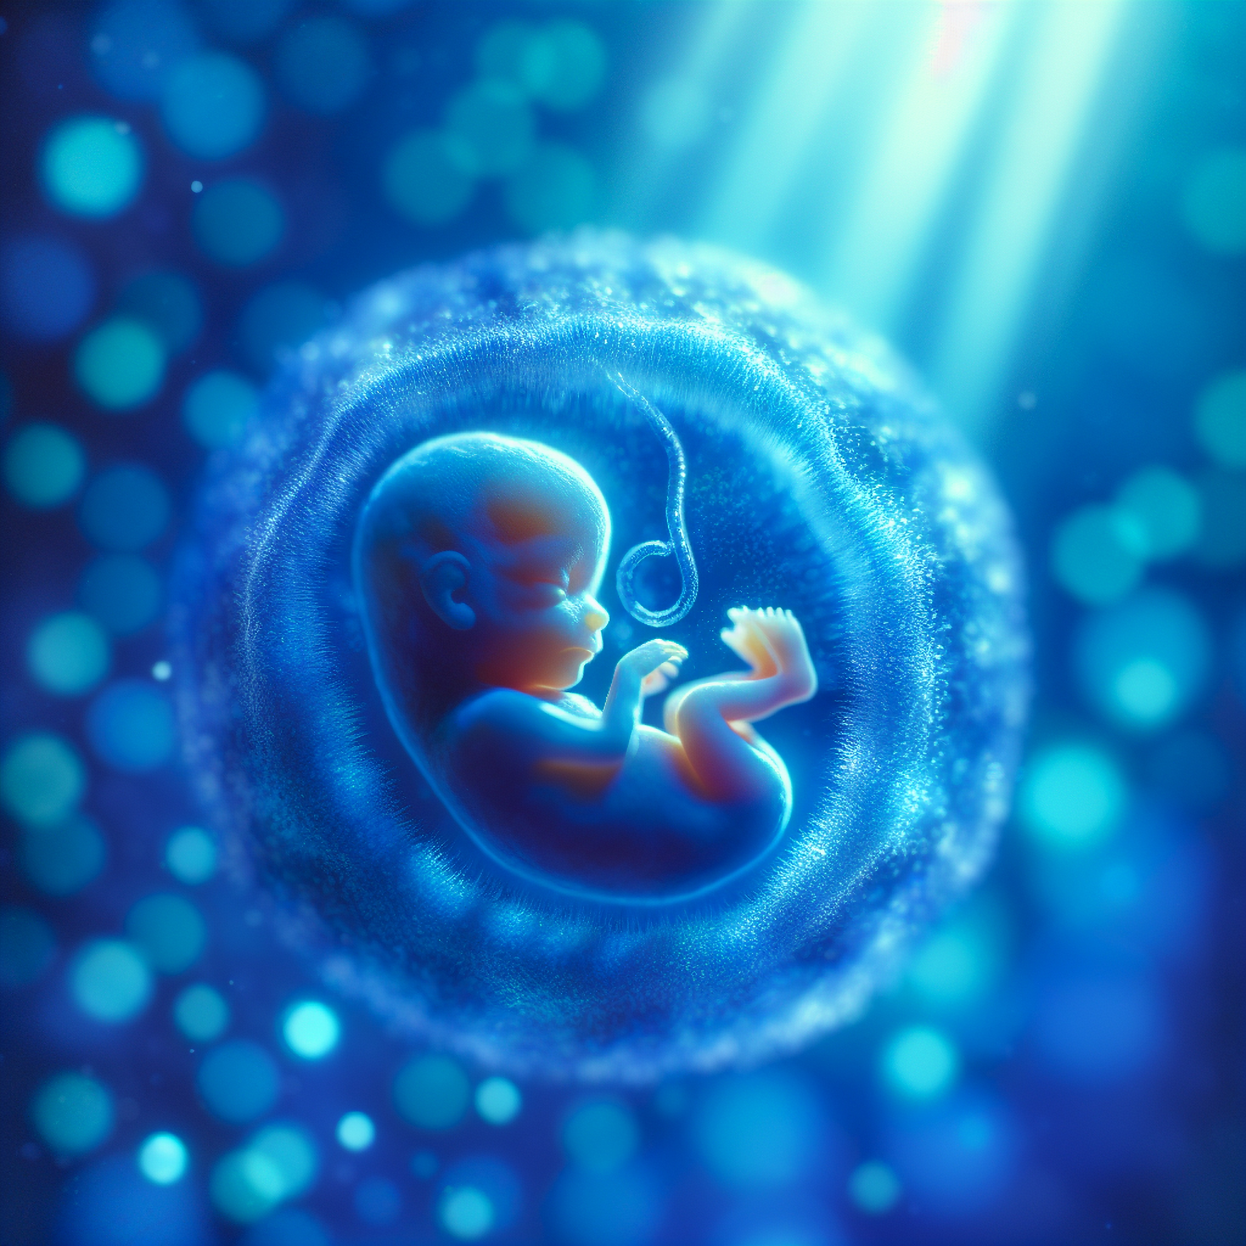
Folic acid
Folic acid is a vitamin,
it is essential during
pregnancy
Females should take
400 µg/day of folic acid
From 4 weeks before
pregnancy until 12 weeks
of pregnancy
This reduces the chance
of having a baby with
problems with their spinal
cord (spina bifida)
People with spinal cord problems may experience severe disabilities
Notes:
Females should take folic acid before they get pregnant to help reduce various disabilities.

Slide 55
Looking after your health when pregnant
FETAL DEVELOPMENT
WEEK
3
4
5
6
7
8
9
16
20-36
38
A fetus is very vulnerable in the first weeks of pregnancy.
When organs develop, they are most vulnerable for external influences (e.g. smoking, alcohol, …).
Organs may not work properly if their development is affected by these substances
Central nervous system
Heart
Arms
Eyes
Legs
Teeth
Palate
External genitals
Ears
Highly sensitive period
Less sensitive period
Notes:
It is also key for the mother to look after her health when she is pregnant.

Slide 56
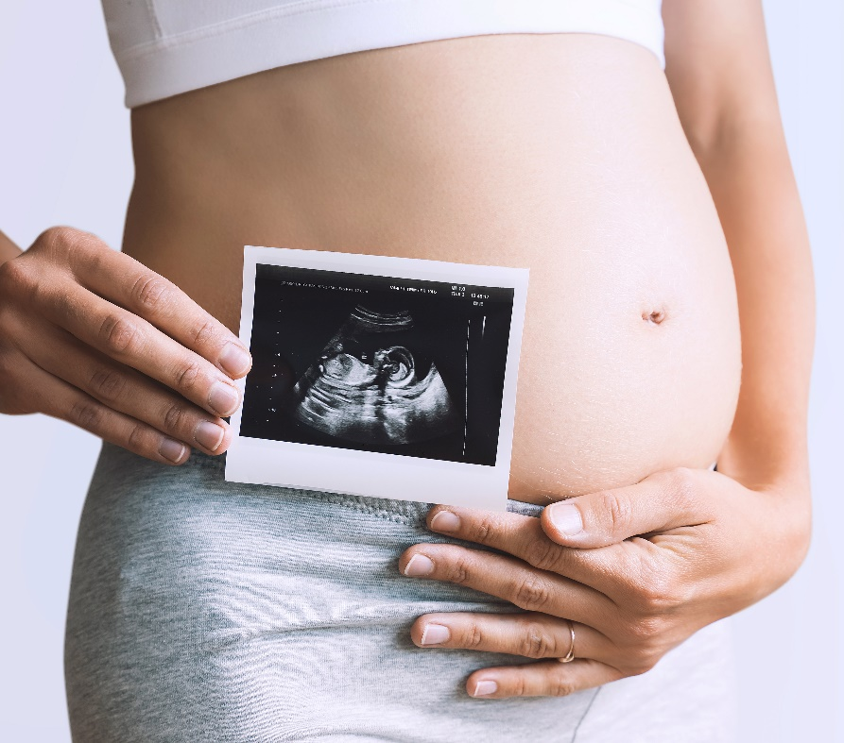
Pregnancy
Lasts 40 weeks
3 trimesters:
weeks 1-12,
13-28, 29-40
Birth of the baby
can be via the vagina
or a Caesarean
Pregnancy can be a time of joy
and excitement, but many changes
are taking place.
These may result in:
Morning sickness
(can happen anytime of the day)
Tiredness
Loneliness
Mental health issues
Notes:
Pregnancy lasts for 40 weeks and is made up of three trimesters.

Slide 57
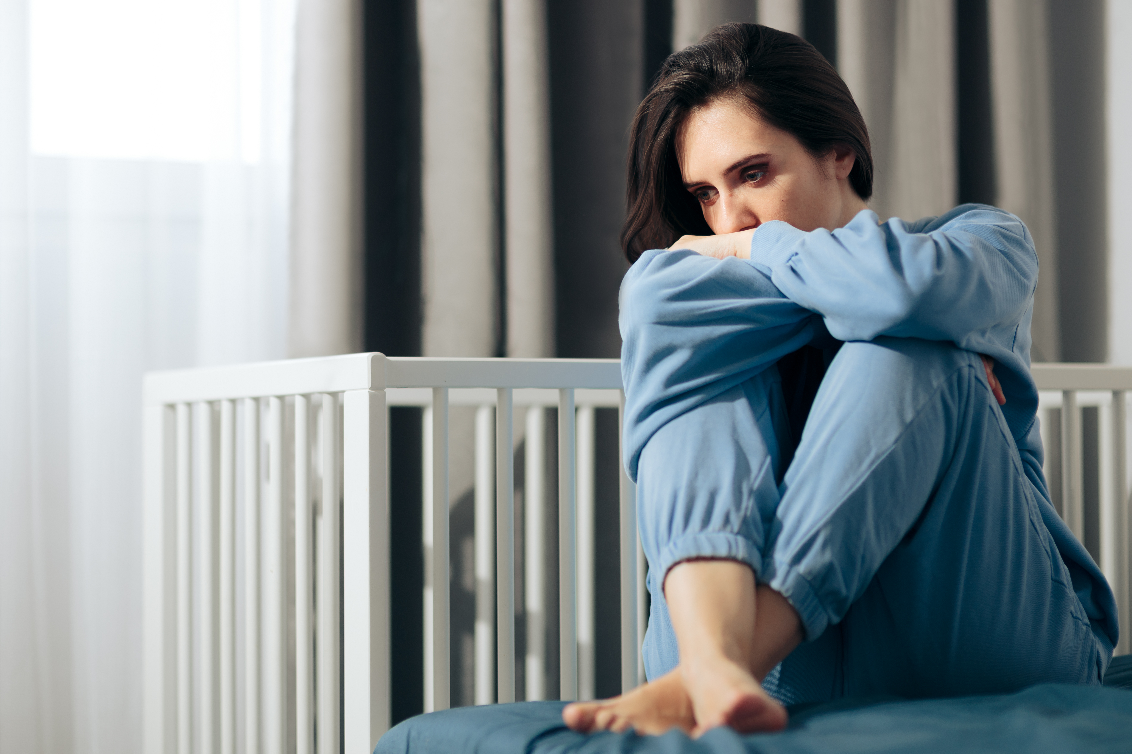
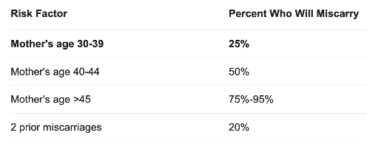
Miscarriage is common
About 20-25% pregnancies miscarry before 24 weeks
Majority in the first 10 weeks
Sometimes people do not tell friends/family they are pregnant until they are over the first three months when miscarriage is most likely
Couples who suffer a miscarriage may need counselling and support
Risk of miscarriage increases
with a female’s age
But also, men over 40 –
increased risk of miscarriage
Notes:
It is important to discuss miscarriage with teenagers as this is a topic that is rarely discussed and people do not realise how common it is. They often only learn about it when they have suffered from a miscarriage.
Included are some statistics on miscarriage. The table shows how the risk of miscarriage increases with the age of the female – mainly due to the chromosome problems in her eggs.

Slide 58

Menopause
Notes:
It is a good idea to introduce the topic of menopause at school. Teenagers may be surrounded by females going through menopause: their mother, teachers, etc. As they go through puberty and females go through menopause, hormonal changes can have profound effects on how they feel and behave.
Question:
Do you think you know anyone who is currently going through the menopause? Yes, No, Not sure. The discussion point here is that they do – their mother or teacher.

Slide 59
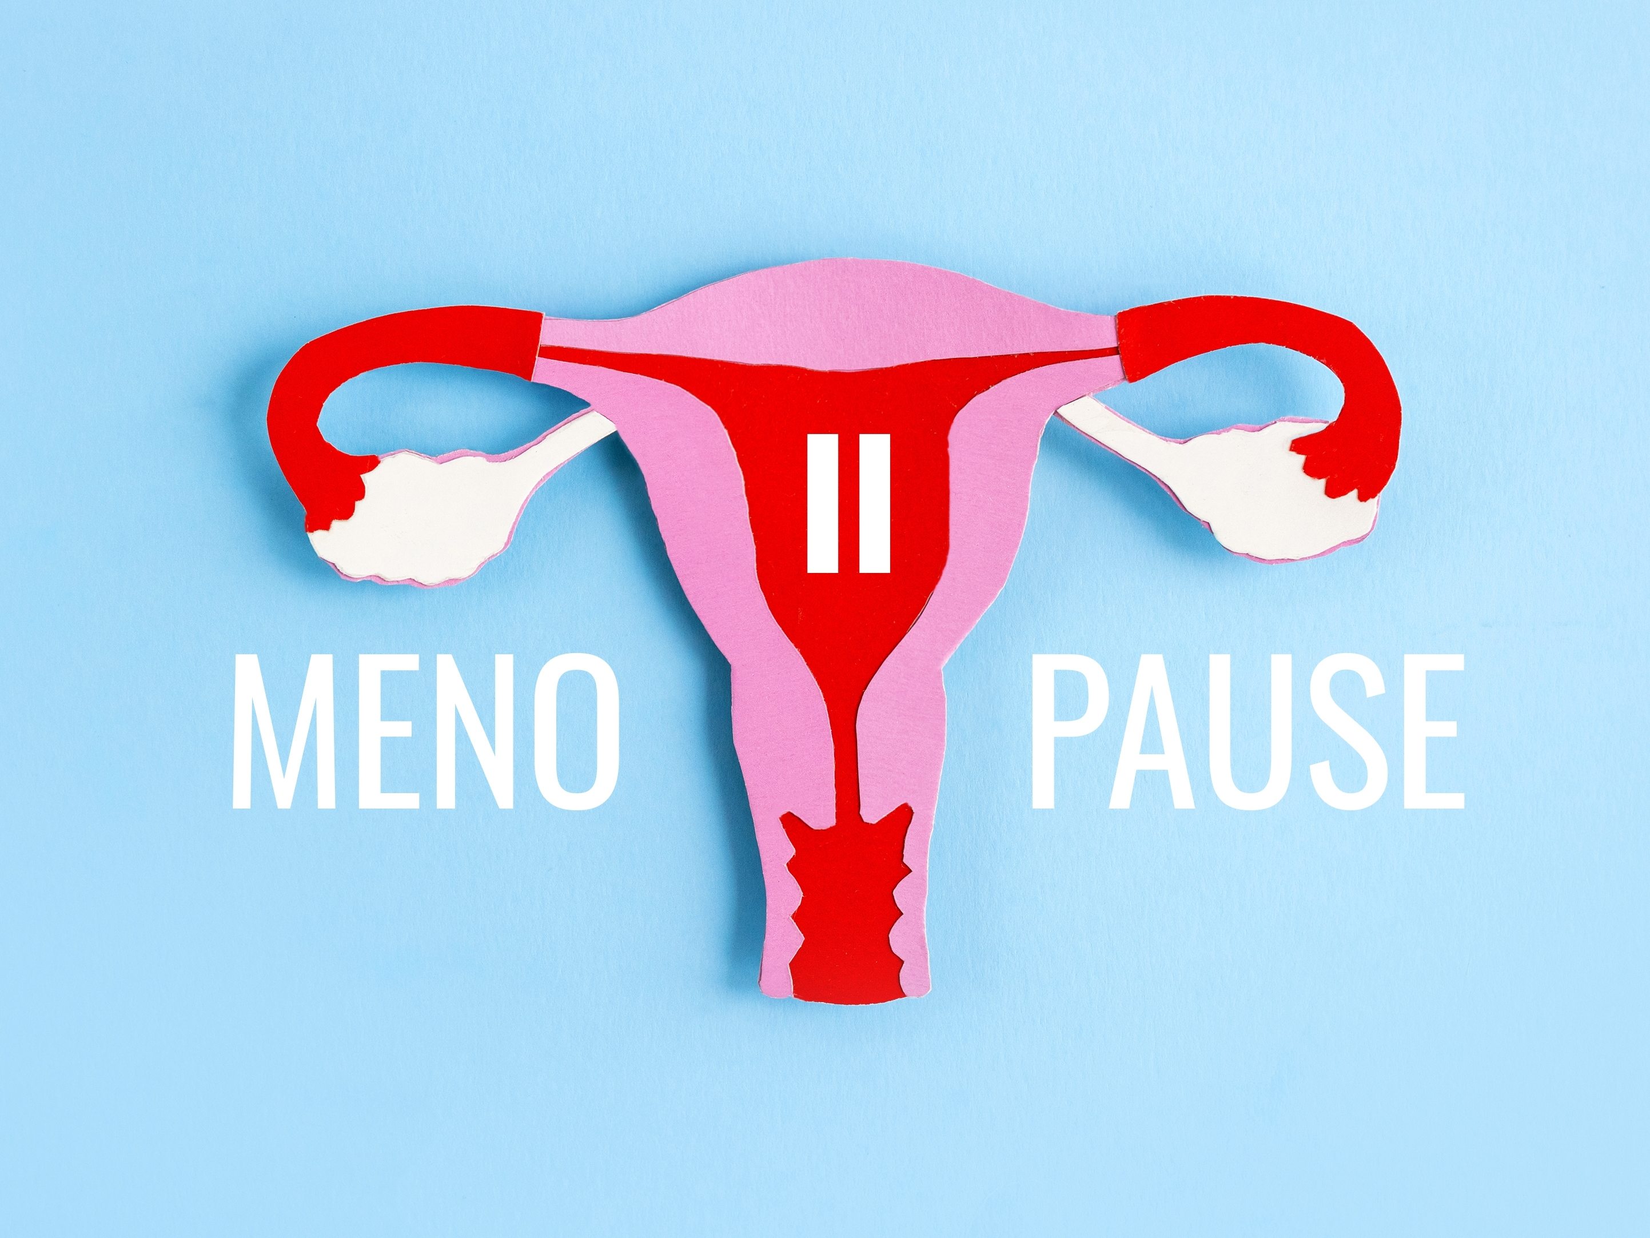
What is the menopause?
Periods stop
No more menstrual cycles –
can no longer get pregnant
Every female has a different experience
Definitions:
Menopause – not had a
period for one year – then the female is in post menopause
Most females stop their
periods between ages 45-55
The average age females
stop their periods is 51
Peri-menopause
the time before the menopause usually
starts when the periods start to change
Periods may become longer or shorter,
heavier or lighter and may become more painful
Eventually the periods stop
Peri-menopause can be a difficult transition, associated with symptoms, up to 10 years before menopause
Like puberty in reverse
The menstrual cycle hormones are cycling down
In puberty they are cycling up
Notes:
It is important to explain what menopause is as most teenagers do not know. Explaining that it is like puberty in reverse may help the teenagers relate to it. In puberty hormones are spiraling up and in the menopause they are spiraling down.

Slide 60

Perimenopause symptoms
80% of females may get symptoms
Most common:
Changes in periods
which eventually stop
Hot flushes and night sweats
a sudden feeling of being really hot which may affect sleep if happens at night
Vaginal issues such as
vaginal dryness which may
cause problems having sex
Changes in periods
which eventually stop
Hot
flushes
Night
sweats
Mental health issues such as irritability, poor concentration, poor memory, brain fog, low mood, mood swings, lack of motivation, reduced confidence, anxiety, fatigue
Symptoms may start in a females’s 30s or early 40s
Some will need treatment
Vaginal
issues
Irritability, poor concentration, poor memory, brain fog
Low mood,
Mood Swings
Lack of motivation, reduced confidence, anxiety, fatigue
Notes:
It is key for students to know the key menopause symptoms to understand what females are experiencing.

Slide 61

Life post menopause
Many females enter a new phase of their lives
which may be a very exciting experience
No more menstrual cycle
No more periods
No more premenstrual syndrome
No more need for contraception
Notes:
Globally we have a very negative narrative about menopause and it is important to explain that there are some very positive points about being post-menopausal, but that the transition through it can be hard for most. Just as puberty can be hard. Thankfully, menopause symptoms do not usually last forever.

Slide 62

The male menopause – andropause
There is a progressive reduction in testosterone levels
Male changes are very different and less intense than the female menopause.
However, many males will be affected by
the changes in their prostate glands and
other parts of their anatomy
Notes:
This is controversial and some people have told us this slide should not be included. It is up to the teachers to decide if they wish to explore this.

Slide 63

Cancers affecting the reproductive system
Notes:
It is important to understand reproductive cancers.

Slide 64
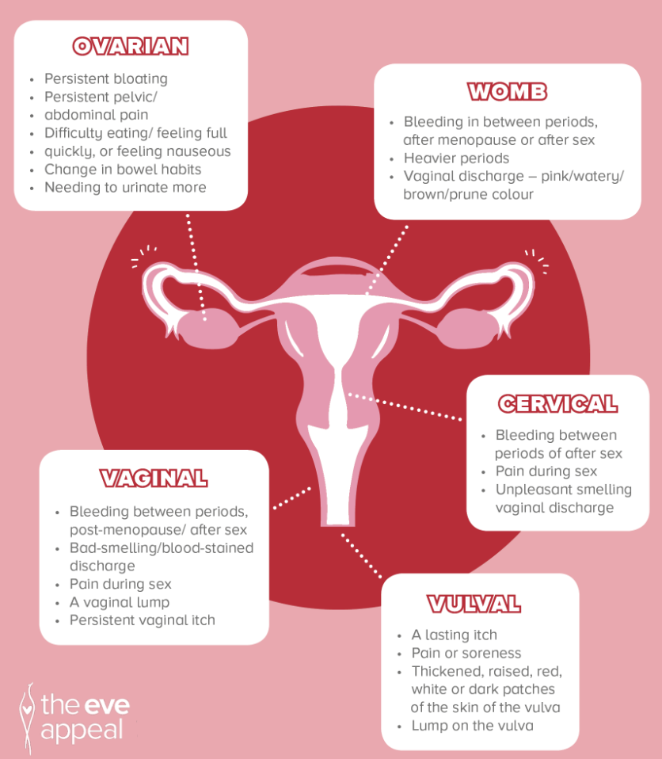
Cancers
affecting
the female
reproductive
system
There can be good outcomes for
those with these cancers if they are
detected early
For further information – visit https://eveappeal.org.uk/
Notes:
It is important for everyone to know about female reproductive cancers. There are certain tests that can be done to reduce the risk, such as cervical smears and mammograms. They should be encouraged to seek medical help if they have any concerns.

Slide 65
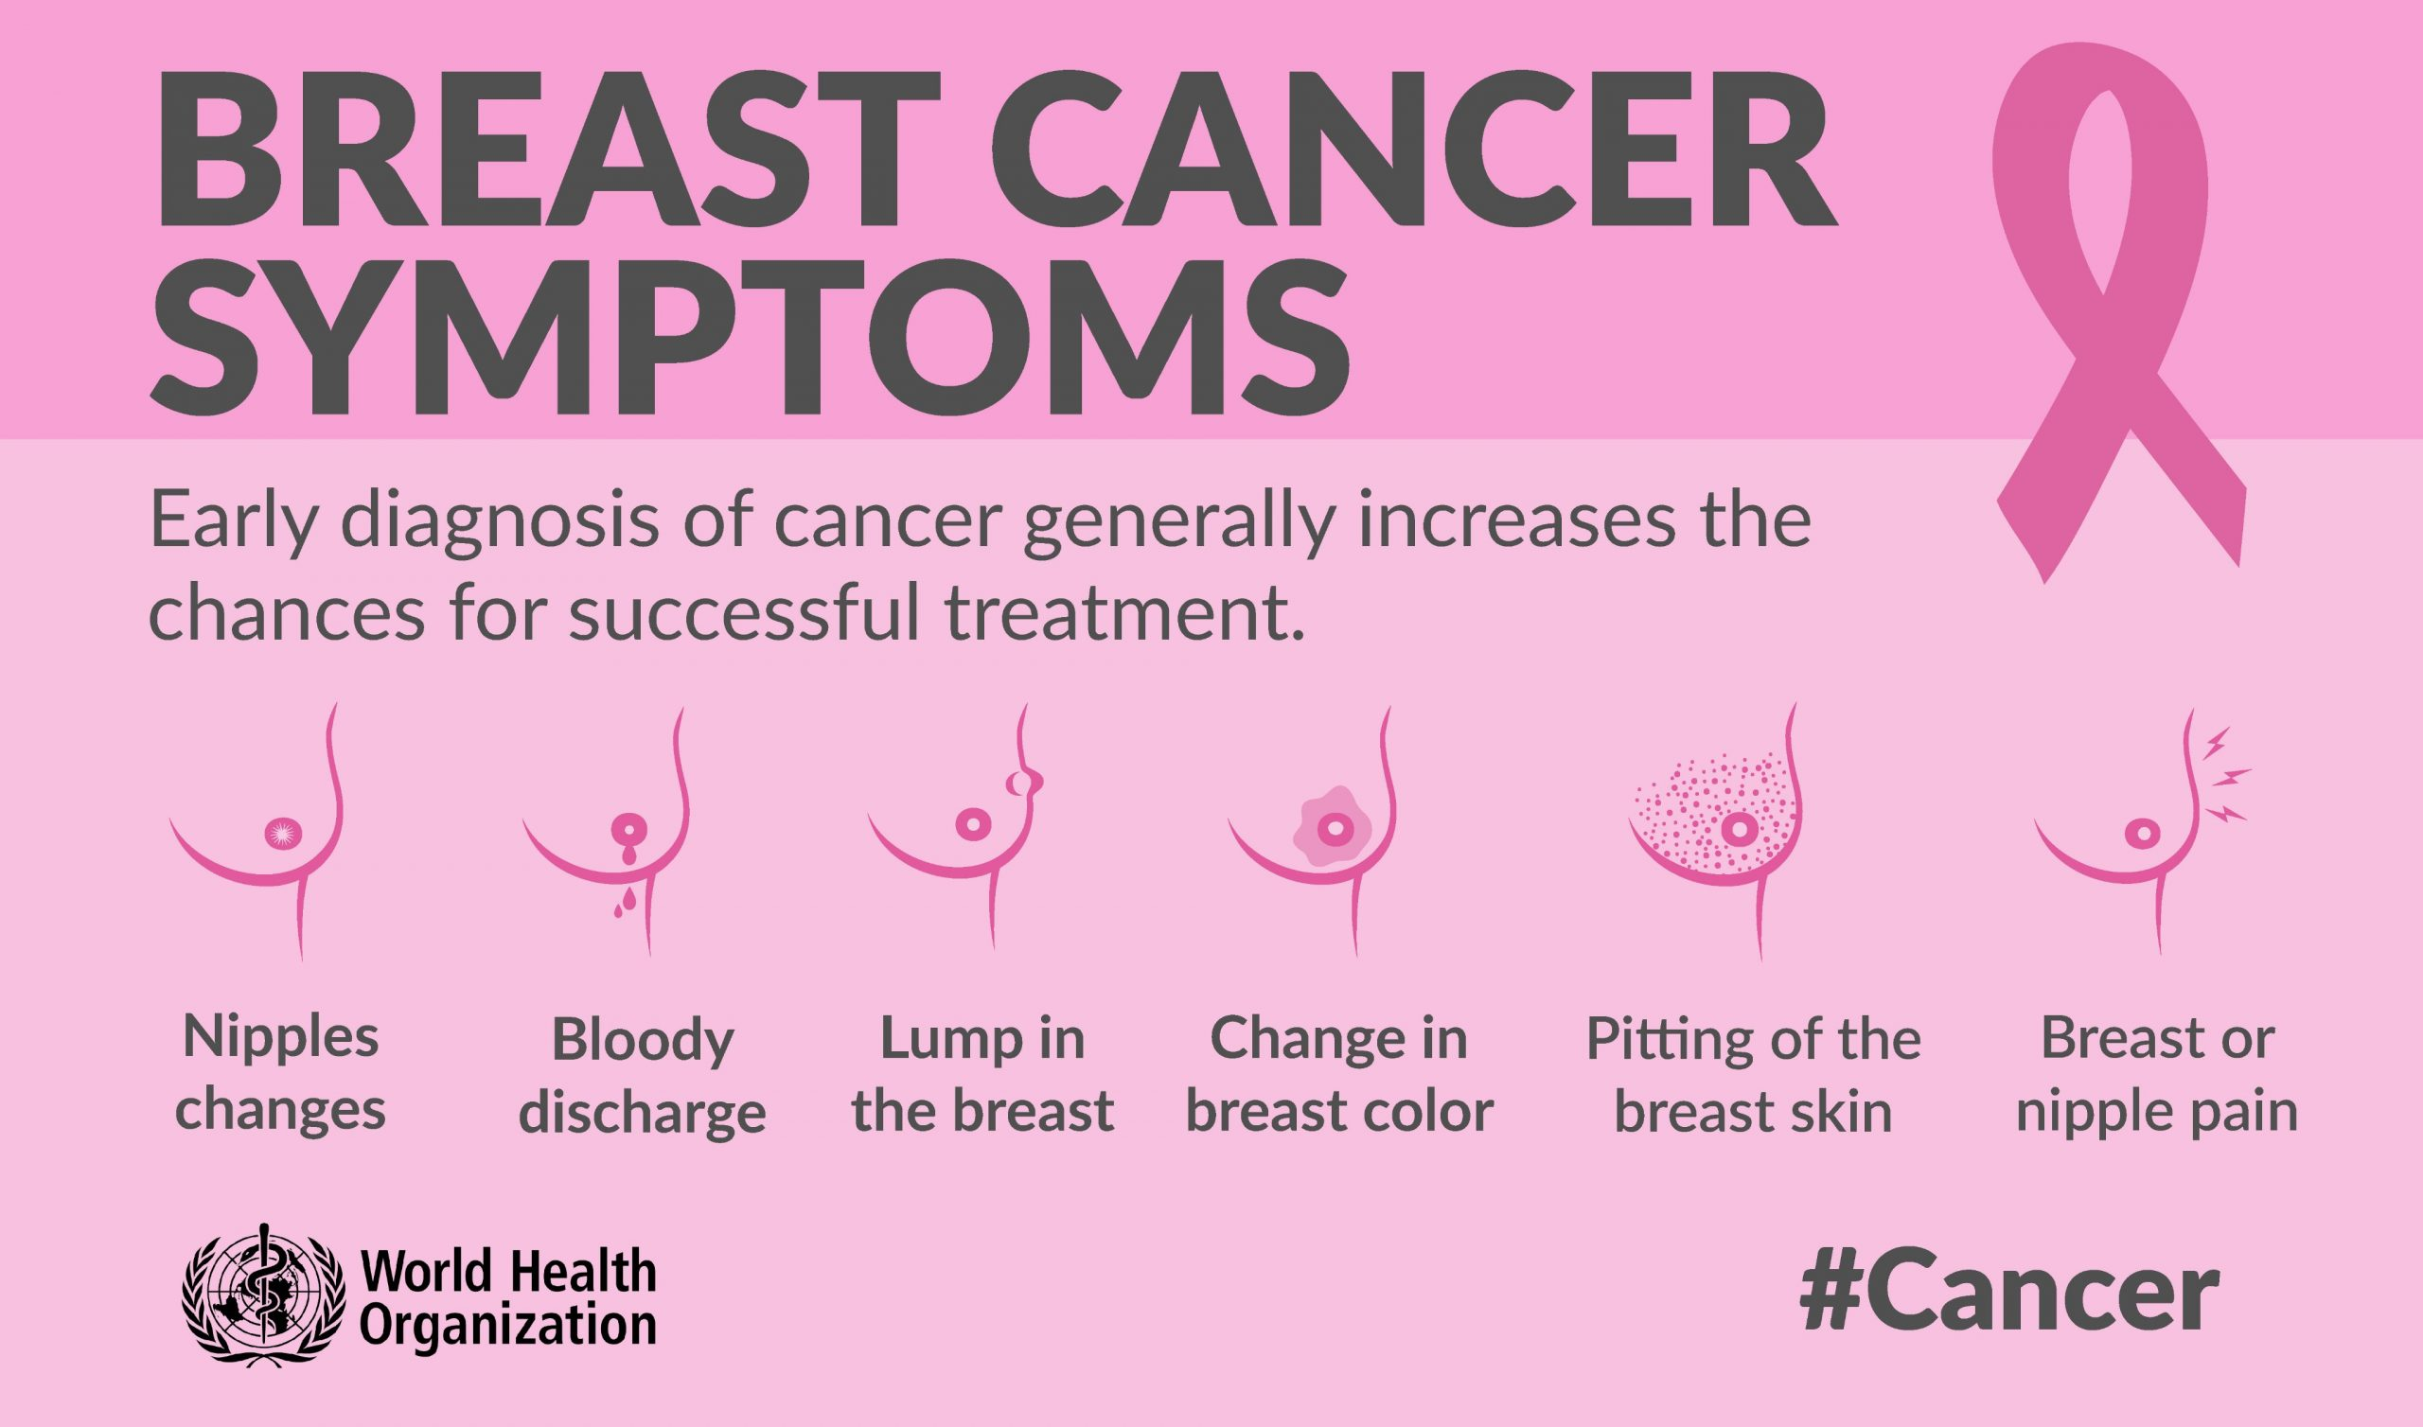
Breast cancer
How common is it?
Most common cancer
in females
Most common over
age 50 but can happen
at any age
1 in 7 females will get
breast cancer
Males can also get it
Some people are
genetically predisposed
to breast cancer
It is important to check breasts regularly and if
you find a lump – go straight to your doctor
Treatment is very successful if it is caught early
Later in life you will be offered a regular mammogram which is
a special test for breast cancer
For further information – visit https://www.who.int/news-room/fact-sheets/detail/breast-cancer
Notes:
It is important to understand how to check breasts from a young age. It is important to be aware that some mothers may have breast cancer and so this may be sensitive for some students.

Slide 66
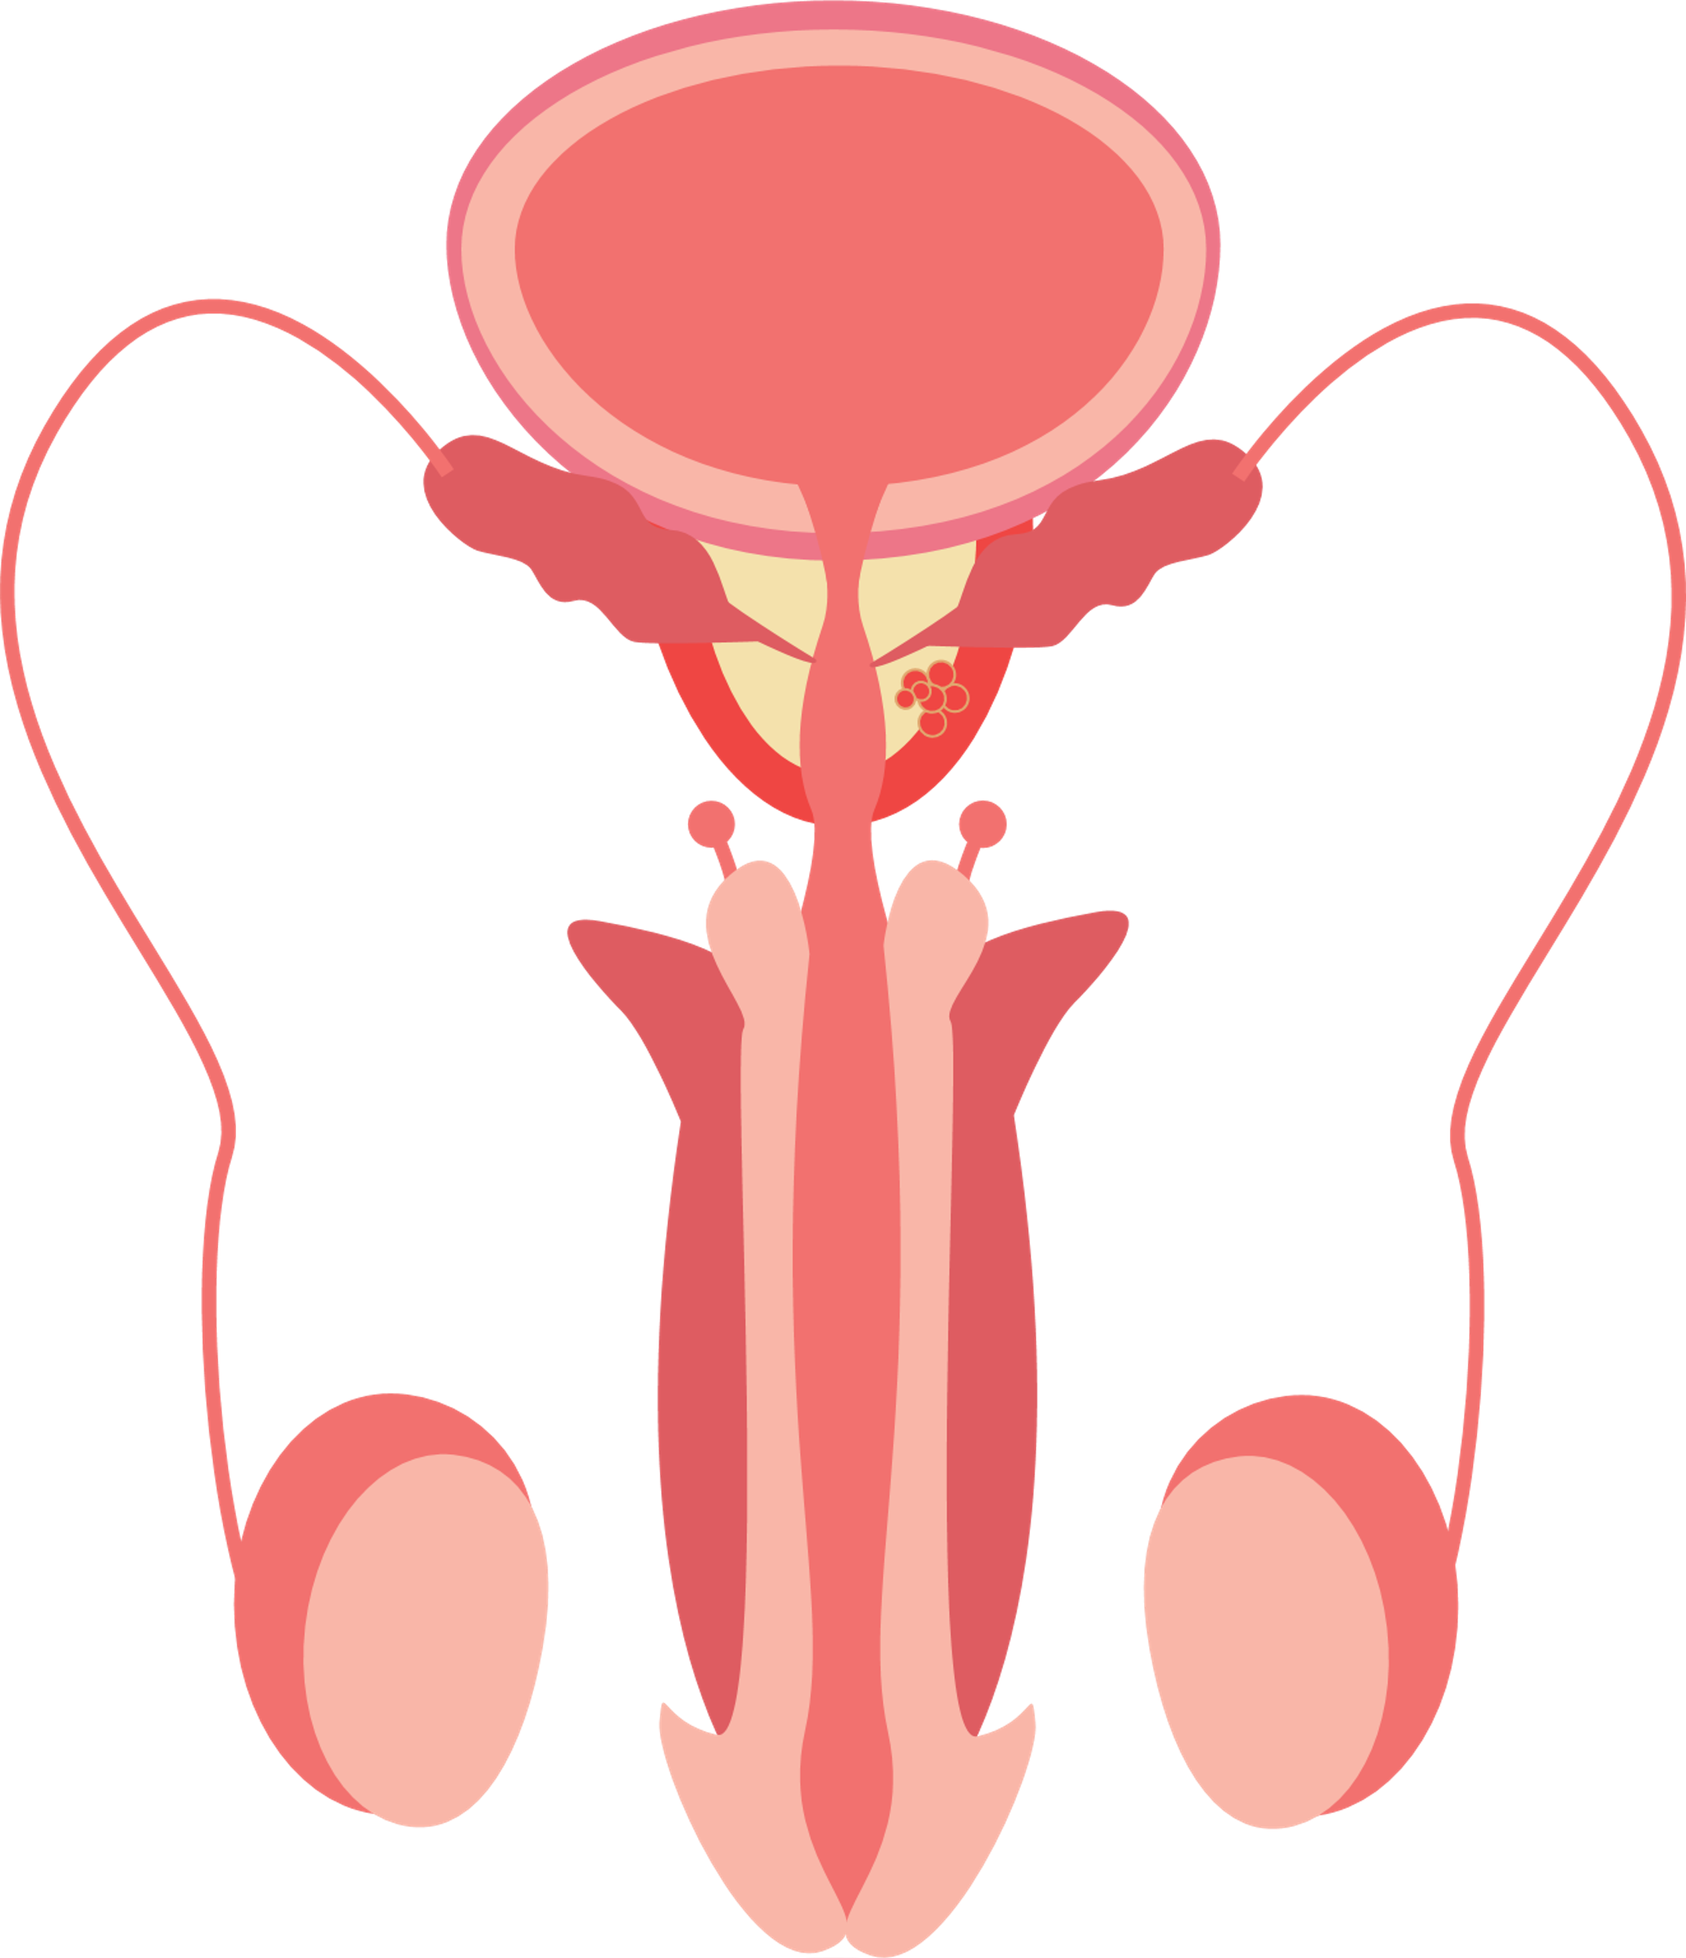
Cancers affect the male reproductive system
Penile cancer
Affects the skin of the penis
and the foreskin
Can start with an ulcer on the penis
Mostly affects men over 50
Prostate cancer
The prostate is a gland inside the pelvis
(the area in the lower belly between the hip bones) that surrounds the urethra (the tube that empties the bladder)
It swells and affects urination
Mostly affects men over 50
Testicular cancer
Swelling or lump in one of the testicles
or any change in shape or texture of the testicles
There can be good outcomes for those with these cancers if they are detected early
Prostate
cancer
Testicular cancer
Notes:
It is important for everyone to know about male reproductive cancers. They should be encouraged to seek medical help if they have any concerns.

Slide 67
Testicular cancer
Testicular cancer is the most common cancer in males 15-34 years old
1 male is diagnosed every hour & 1 male dies a day from it
When detected early 99% of guys diagnosed survive
All it takes is a simple monthly self-exam
How common
is it?
It affects 1% of males
It can affect males
aged 15-65
It is important to check your testes regularly
You need to know what is normal for you
If you notice any changes – go to see your doctor straight away
Notes:
Testicular cancer can affect teenagers. They should be encouraged to check themselves and understand what is normal for them, and that if there are any changes, they should see their doctor.

Slide 68

Wellbeing and lifestyle
Notes:
It is important to understand how wellbeing and lifestyle affects reproductive health and health in general. For example, those having problems with their periods may benefit from looking after their lifestyle.

Slide 69





Optimising Your Reproductive Health
Pillars of wellbeing
Throughout our lives, we need to look
after our pillars of wellbeing:
Nutrition
Exercise
Sleep
Mental health
Community/friendships
Looking after our wellbeing reduces the risk of getting problems during our reproductive life
It can help with period issues, when trying to get pregnant, menopause, and more
When we look after our wellbeing
it decreases the risk of many health conditions that can cause death such as cancer, dementia, heart disease, diabetes and much more
The sooner we look after our wellbeing, the healthier we will
be and feel
Notes:
Looking after our health is key to reproductive health. A healthy diet, not smoking, limited alcohol intake, regular exercise, avoiding environmental chemicals, and getting enough sleep are all important in all stages of reproductive life. This reduces short and long term health conditions. If young people can understand this at school, it will have a positive impact on their health. It is common to see people at key life stages, such as when trying to get pregnant and at perimenopause, trying to then optimize their health. It is better to always have optimum health.
Some of these issues also affect the long term health of the baby.
In the next slides we have gone into each topic in more detail. This overlaps with general health, not just reproductive health. You may cover these topics in other subjects.

Slide 70
Nutrition
Our nutrition involves everything we consume:
it includes food and alcohol
We need to eat a balanced diet to ensure we get the building blocks our body needs such as proteins, fats, carbohydrates, fibre, vitamins, minerals and water
Being overweight has short and long term health consequences and causes 4 million deaths a year due to: all-causes of death, but especially type 2 diabetes, high blood pressure, heart disease, stroke, some cancers
Having poor nutrition
and/or being overweight/ underweight affects menstrual issues, infertility, pregnancy, menopause
We need to:
Eat a balanced diet
Eat the rainbow - which means we eat foods of different colours
Try to avoid too many processed and fast foods which are ready made as they have a negative effect on our health
Try to keep processsed
sugar intake low as it is bad for our health
Notes:
Nutrition has a big effect on reproductive health and understanding this may help some females with the menstrual health.
Questions: Are you eating a healthy diet?
Are you eating a lot of processed foods? How do you feel after eating these meals?

Slide 71

Alcohol
Alcohol – is a neurotoxin
It is one of the biggest causes of some cancers and is a major health risk causing 3 million deaths a year globally
Cancers that are increased due to alcohol include breast and bowel
Increases the risk of strokes, heart disease, liver disease and damage to the brain and nervous system
It is considered the number 1 date rape drug. A drunk person cannot give consent
It can affect periods, chances of getting pregnant and the menopause
And drinking when a teenager can affect our brain and sexual development
A little alcohol may make us feel confident and happy
But one glass can disrupt our mood and energy levels and result in poor sleep and eating patterns
It can make us angry and aggressive
It often causes us to forget the evening
The highest rate of alcohol poisoning is seen in 15–19-year-olds
Adults should have no more than
14 unit a week – 1 bottle of wine
is 10 units
Notes:
The use of alcohol can be an issue for some teenagers. Discussing this gives the opportunity to discuss the short and long term health risks. And the effect of alcohol on reproductive health.
Question: How is your relationship with alcohol?
Do you sometimes forget what has happened during the evening?
Do you feel a drunk person can give consent to sex?
If you drink alcohol – how do you feel the next day?

Slide 72


Vaping, smoking, and snus
They are seriously bad for our health, are highly addictive, and lead to many deaths
More than 8 million people die
from tobacco every year
They pose serious and avoidable health risks
In teenagers, these products
cause long term harm to brain development
Smoking reduces fertility,
but we do not know the effects
of vaping and snus
Smoking
causes cancer, heart disease, stroke, lung diseases, diabetes,
and chronic obstructive pulmonary disease, which includes emphysema and chronic bronchitis.
Vaping
the long term affects are unknown
We know it increases asthma, lung scarring and tissue damage
The vapor can contain toxins which may cause cancer
Snus – some teenagers are putting this tobacco product in their mouths
Snus products may contain thousands of chemicals including nicotine
It affects the cardiovascular system and increases the risk of cancer
Notes:
The evidence for smoking and reproductive health is established. Since vaping is new – there is only very recent evidence to show that it can affect reproductive health. The data on snus is limited but we know nicotine affects reproductive health. Snus has been promoted by some international footballers. It is where a nicotine pouch is kept in the mouth.
Question – do you vape or use snus?
Do you smoke cigarettes?
How does smoking or vaping make you feel?

Slide 73
Exercise/physical activity
Exercise extends our life.
3.2 million people die every year through lack of exercise
Exercise significantly reduces many health issues including:
Menstrual and menopause symptoms, heart disease, Alzheimer’s and dementia, hypertension, chronic respiratory disease, stroke, diabetes, various types of cancer (including breast cancer and colon cancer), stress, anxiety and depression
The sooner you start, the
more impact you will have
on your health
Exercising can boost your
energy levels, increase your
self-esteem, and confidence, reduce depression, and if
done with friends, can prevent loneliness
You should do at least 150 minutes of moderate activity or 75 minutes of vigorous activity throughout the week which can be increased to 300 minutes of moderate activity for additional health benefits but beware of over exercising
Notes:
It is essential that we encourage teenagers to understand the short and long term benefits of exercise on their reproductive and general health. It is not about what they look like, it is more about how it makes them feel. It is really important for mental and physical health.
Question – how often are you exercising?
What sort of exercise do you do?

Slide 74
Sleep
If you do not sleep enough, it affects your physical and mental health
A lack of sleep adversely affects our wellbeing; it makes us irritable, affects our memory, reduces our immunity, and can lead to obesity, heart disease and type 2 diabetes.
During sleep our body repairs and resets
Lack of sleep can affect the menstrual cycle, causing irregular period and make getting pregnant difficult
1 in 3 have fallen asleep whilst driving which accounts for 25% accidents on major roads
Ideally, we need 8 hours sleep, even more important when you are a teenager
Switch your screens off at least an hour before bed
Keep your bedroom like a sanctuary, tidy and free from anything related to school or gaming if you can
Avoid alcohol and caffeine as they disrupt sleep
Try to go to bed around the same time every night
Many teenagers feel they need to stay up late but we should be awake when it is light and asleep when it is dark
Notes:
We know that teenagers do not sleep enough and they have trouble sleeping. It is not helped by their screen use. Lack of sleep affects their reproductive and general health.
Questions – how many hours sleep do you get a night?
What problems do you have trying to get to sleep?

Slide 75
Mental health
It affects how we think, feel, and act. It also helps determine how we handle stress, relate to others, and make healthy choices.
Mental health is important at every stage of life, from childhood and adolescence through adulthood.
It can affect the menstrual cycle and make it difficult to get pregnant
Depression
increases the risk for many types of physical health problems, particularly long-lasting conditions like diabetes, heart disease and stroke.
Stress
results from adverse or demanding circumstances
Anxiety
comes from a place of fear, nervousness and worry
To help our mental health:
Eat healthily
Exercise regularly
Make sleep a priority and try relaxation methods such as meditation and mindfulness
Seek support from friends and your community
Notes:
Mental health is a huge topic that schools cover elsewhere. It is also important for reproductive health.

Slide 76
Community and friendships
Friends play a significant role in promoting your overall health.
Adults with strong social connections have a reduced risk of many significant health problems, including depression, high blood pressure, an unhealthy body mass index (BMI), better cardiovascular health and a longer life
Talking to your friends about reproductive health issues, such as the menstrual cycle and infertility, can be very supportive
Being part of a supportive friendship group can combat loneliness and reduce risk-taking behaviours
Join a club inside or outside school
Keep in regular contact with your friends
If you have a problem, hopefully you can share this with your friends, and they will be supportive
Notes:
Data is showing that teenagers get a lot of support from each other. Research has found that girls can have useful support from their friends such as during their period.
Question – do you discuss periods and other reproductive health issues with your friends? Or your parents? Or your teachers?

Slide 77
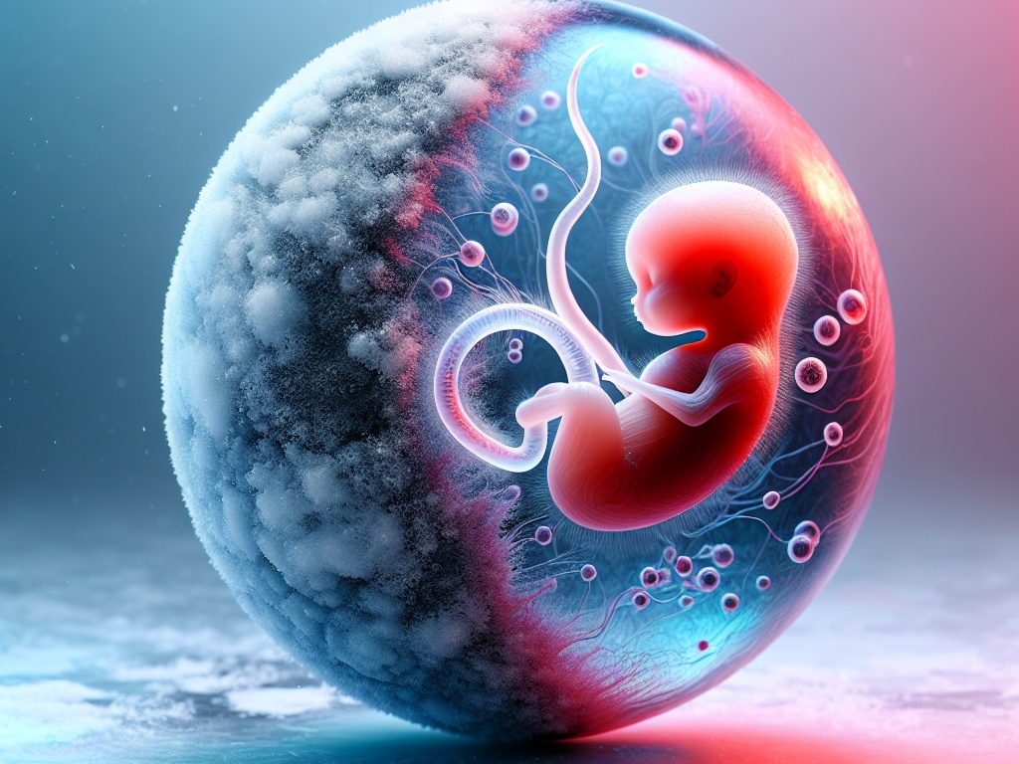
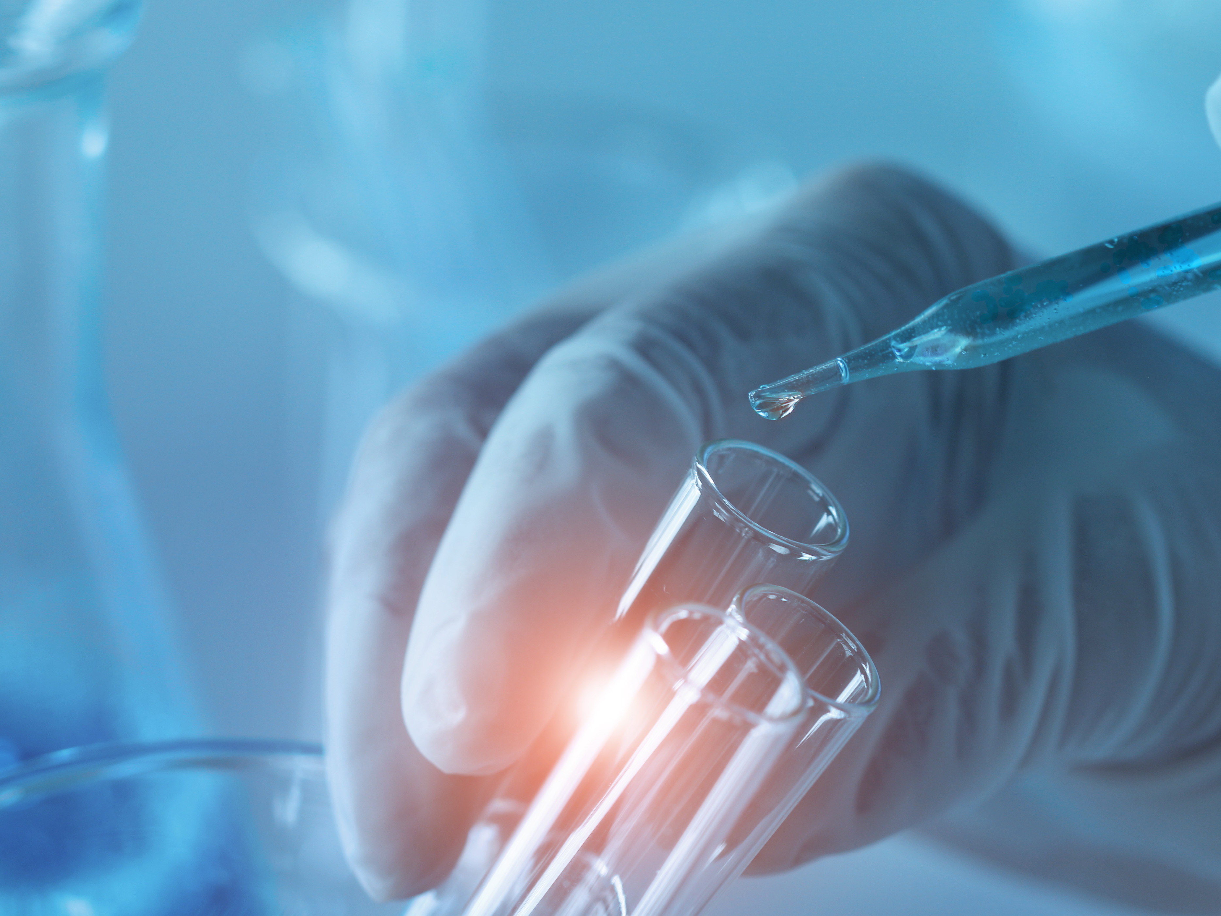
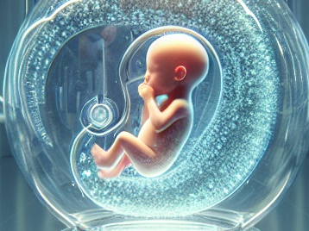
Could technology change the way we have
our future children?
Future babies through
frozen eggs
Stem cells to make
eggs and sperm
Artificial
wombs
Notes:
In the future, we may see more egg freezing, more same sex-couples and single people having children.
Question – Have they seen the drama The Handmaid’s Tale or read the book?
Why have we put the Kardashians on the slide? Answer – Kim had surrogacy.
In the film GATTACA almost everyone reproduces by IVF and genetic testing to make sure everyone has the best genes. This technology is fast approaching. We should encourage them to read Brave New World – written almost 100 years ago where there are no more families, all babies are born after IVF and develop in an artificial womb. At some point, science will be able to make eggs and sperm from stem cells and we will have artificial wombs but we have no idea when this will be possible.

Slide 78

Take home messages

Slide 79
Take home messages
Understand
what is normal
Learn about reproductive health
Your lifestyle is key to your health
Practice safe sex
Prevent infertility
Fertility treatment is not an easy option
Identify cancer early
Make informed choices
Notes:
A short summary. And hopefully a discussion about what they have learnt.

Slide 80

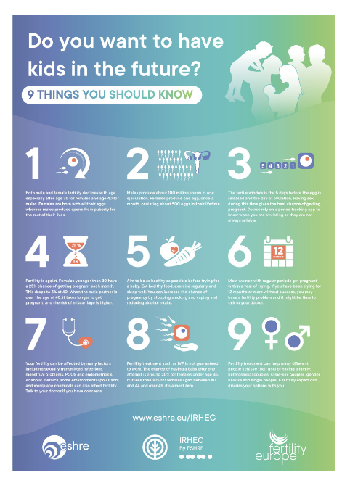


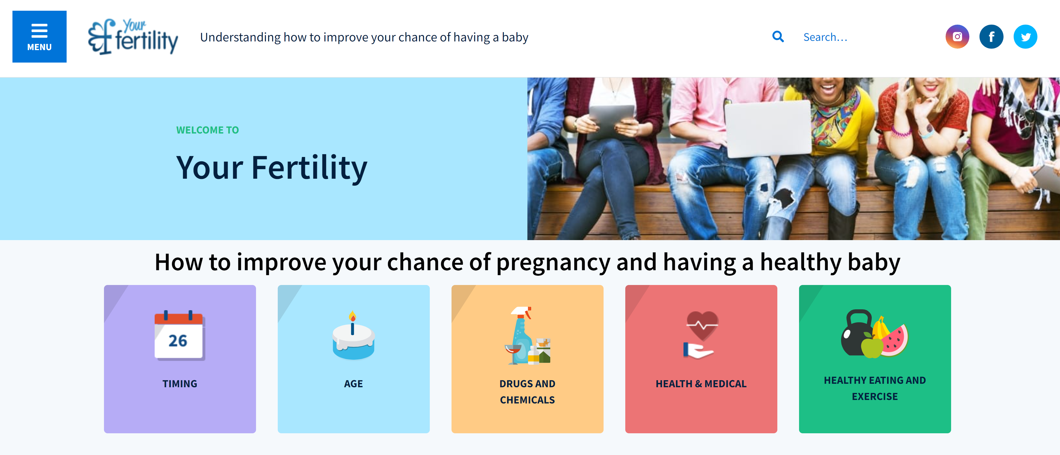
Read more
International Reproductive Health Education Collaboration: www.eshre.eu/IRHEC
A really useful web site from Australia is https://www.yourfertility.org.au/
Notes:
This is meant as an introduction to Reproductive Health and Fertility Education produced by the International Reproductive Health Education Collaboration. If you would like further teaching resources, please contact the Past Chair of IRHEC Joyce Harper joyce.harper@ucl.ac.uk
Further information produced by the International Reproductive Health Education Collaboration https://www.eshre.eu/irhec
We are in the process of producing a number of information leaflets listed below. These will be on our web site very soon https://www.eshre.eu/irhec
Menstrual cycle – periods and ovulation
Preconception health
Pregnancy
Female fertility
Male fertility
Is there a female fertility test?
Testing for female infertility
Testing for male infertility
What causes infertility
Infertility treatments
Miscarriage
Menopause and fertility
PCOS
Endometriosis
Egg freezing
Using donor eggs and sperm
Surrogacy
Fertility Education Poster – copies of this are available at https://www.eshre.eu/irhec in several different languages.

